Slide 1
19CSE305 – Machine Learning Heart Attack Predictor
TEAM MEMBERS
CB.EN.U4CSE21002 - Abhinav Saravanakumar
CB.EN.U4CSE21015 - Dharaneesh P
CB.EN.U4CSE21020 - Guruprasath M
CB.EN.U4CSE21045 - Praveen N

Slide 2
Introduction
This project endeavors to fundamentally transform the landscape of heart attack prediction and prevention. Our team has crafted a sophisticated machine learning model for heart attack prediction, utilizing an array of advanced pre-processing techniques and state-of-the-art machine learning algorithms. Our objective is to optimize the model's efficiency while emphasizing the delivery of precise predictions. Through this endeavor, we aim to usher in a new era of cardiac health monitoring, taking us one step closer to proactive heart attack prevention and improved patient care.

Slide 3
Motivation/Significance
Cardiovascular diseases, notably heart attacks, are a major global health concern, causing a significant number of deaths worldwide, necessitating urgent action.
Our motivation stems from the need to transition from reactive to proactive cardiac health management. Traditional risk factors have limitations, and we aim to enhance heart attack prediction using advanced machine learning techniques.
The project aligns with the trend of personalized medicine, offering tailored care plans based on individual risk factors.
This project has the potential to transform cardiology and showcase the power of machine learning in addressing critical health challenges, paving the way for proactive heart attack prevention and enhanced cardiac healthcare.

Slide 4
Challenges
Obtaining high-quality and comprehensive datasets is often a challenge. Real-life medical data may contain missing values, errors, or inconsistencies, which can affect the model's accuracy.
Healthcare data is sensitive, and there are strict regulations, like HIPAA in the United States, that must be adhered to. Ensuring data privacy and security while working with patient records can be a significant challenge.
Identifying the most relevant features or risk factors for heart attacks can be challenging. Including irrelevant or redundant features can lead to overfitting, while omitting crucial ones can reduce model performance.
Models that work well in one dataset or geographic region may not generalize to others. Adapting models for diverse populations and healthcare systems is a challenge.
Rigorous testing and validation of the model's performance are necessary to ensure it meets the required standards for clinical use.

Slide 5
Dataset Description
UCI Machine Learning Repository
The dataset consists of 303 instances and 14 attributes, including age, sex, chest pain type, resting blood pressure, cholesterol level, fasting blood sugar, electrocardiographic results, maximum heart rate achieved, exercise-induced angina, ST depression, the slope of the peak exercise ST segment, number of major vessels, and thalassemia type.
The primary objective is to predict the presence or absence of heart disease, making it suitable for binary classification tasks.
The dataset includes numerical, categorical, and binary features.
Preprocessing is applied to handle missing values and outliers.
The dataset is credited to the UCI Machine Learning Repository, and appropriate citation guidelines have been followed.

Slide 6
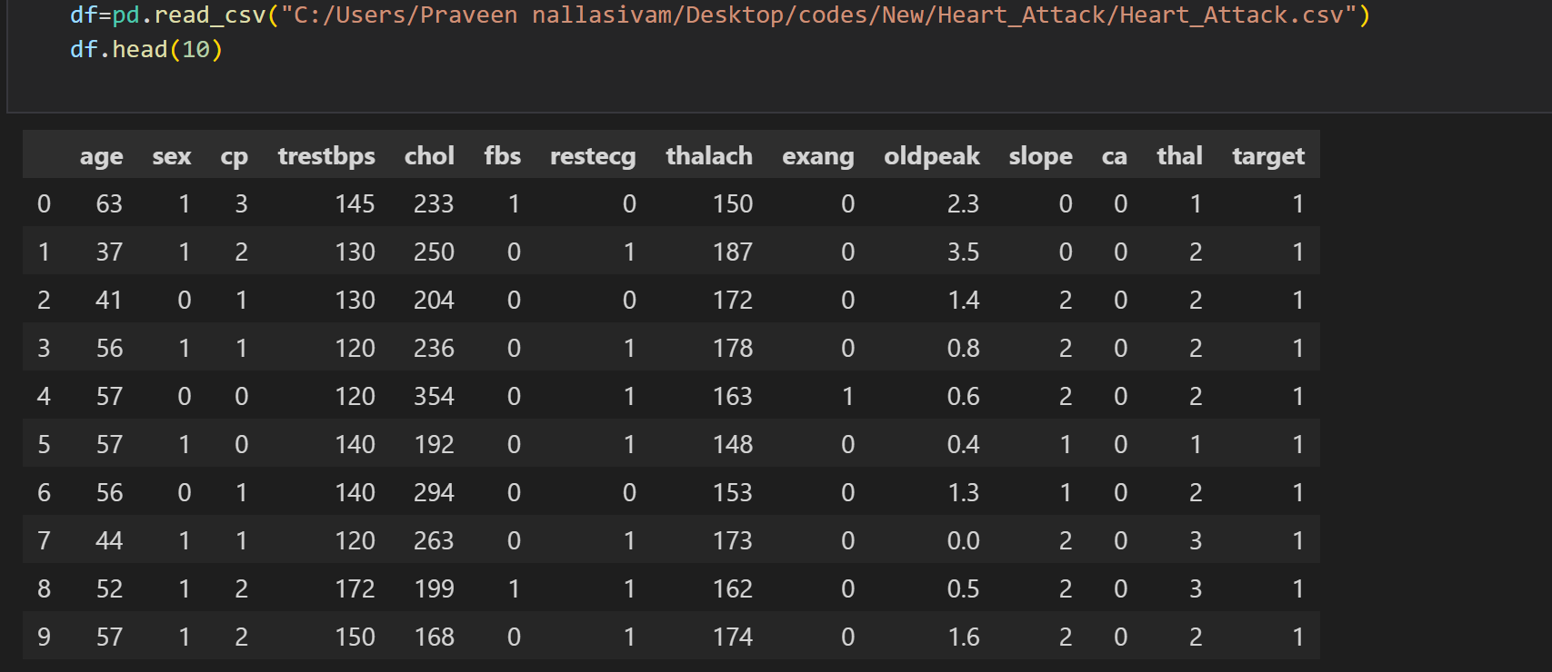
Results
DATA:

Slide 7
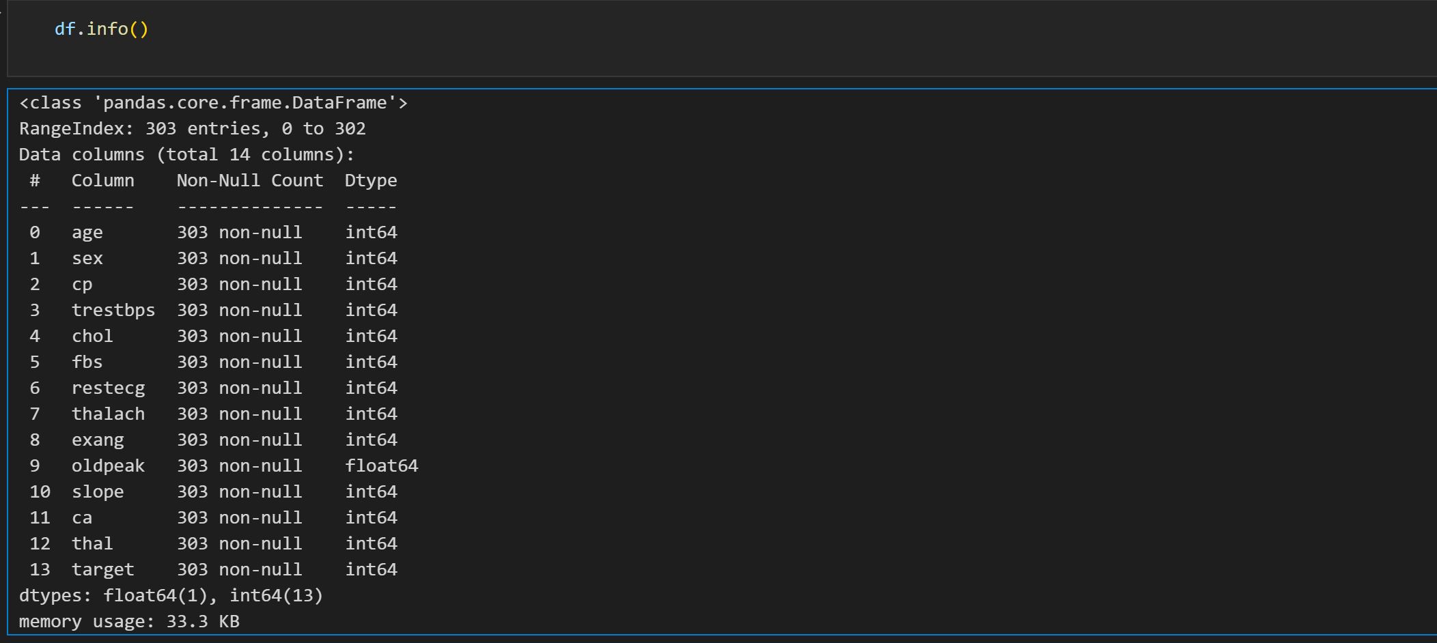
Results
DATA PREPROCESSING:

Slide 8
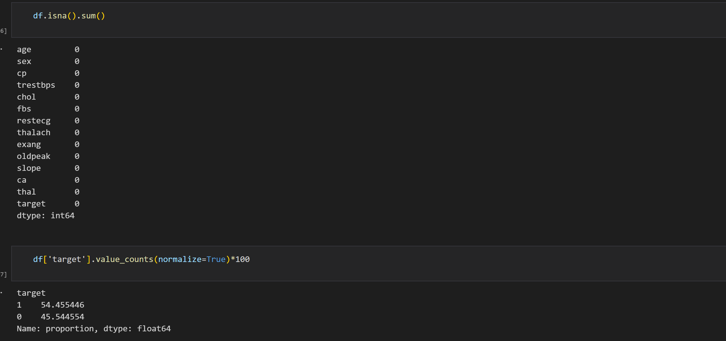
Results
DATA PREPROCESSING:

Slide 9
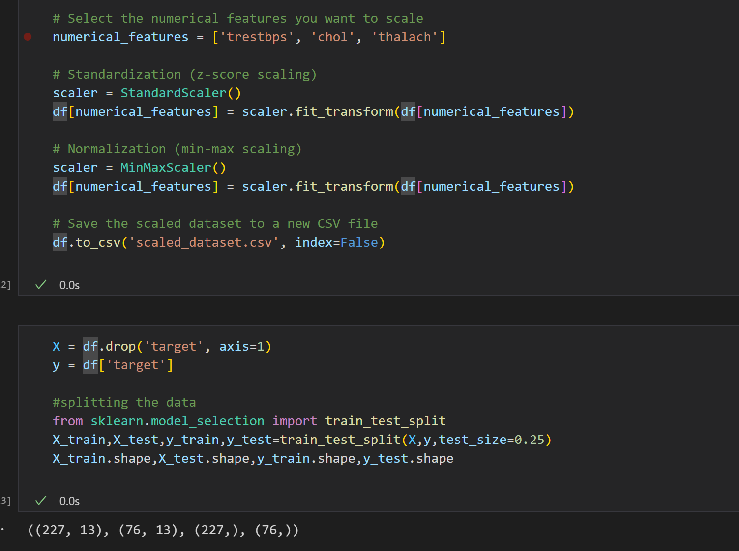
Results
DATA PREPROCESSING:

Slide 10
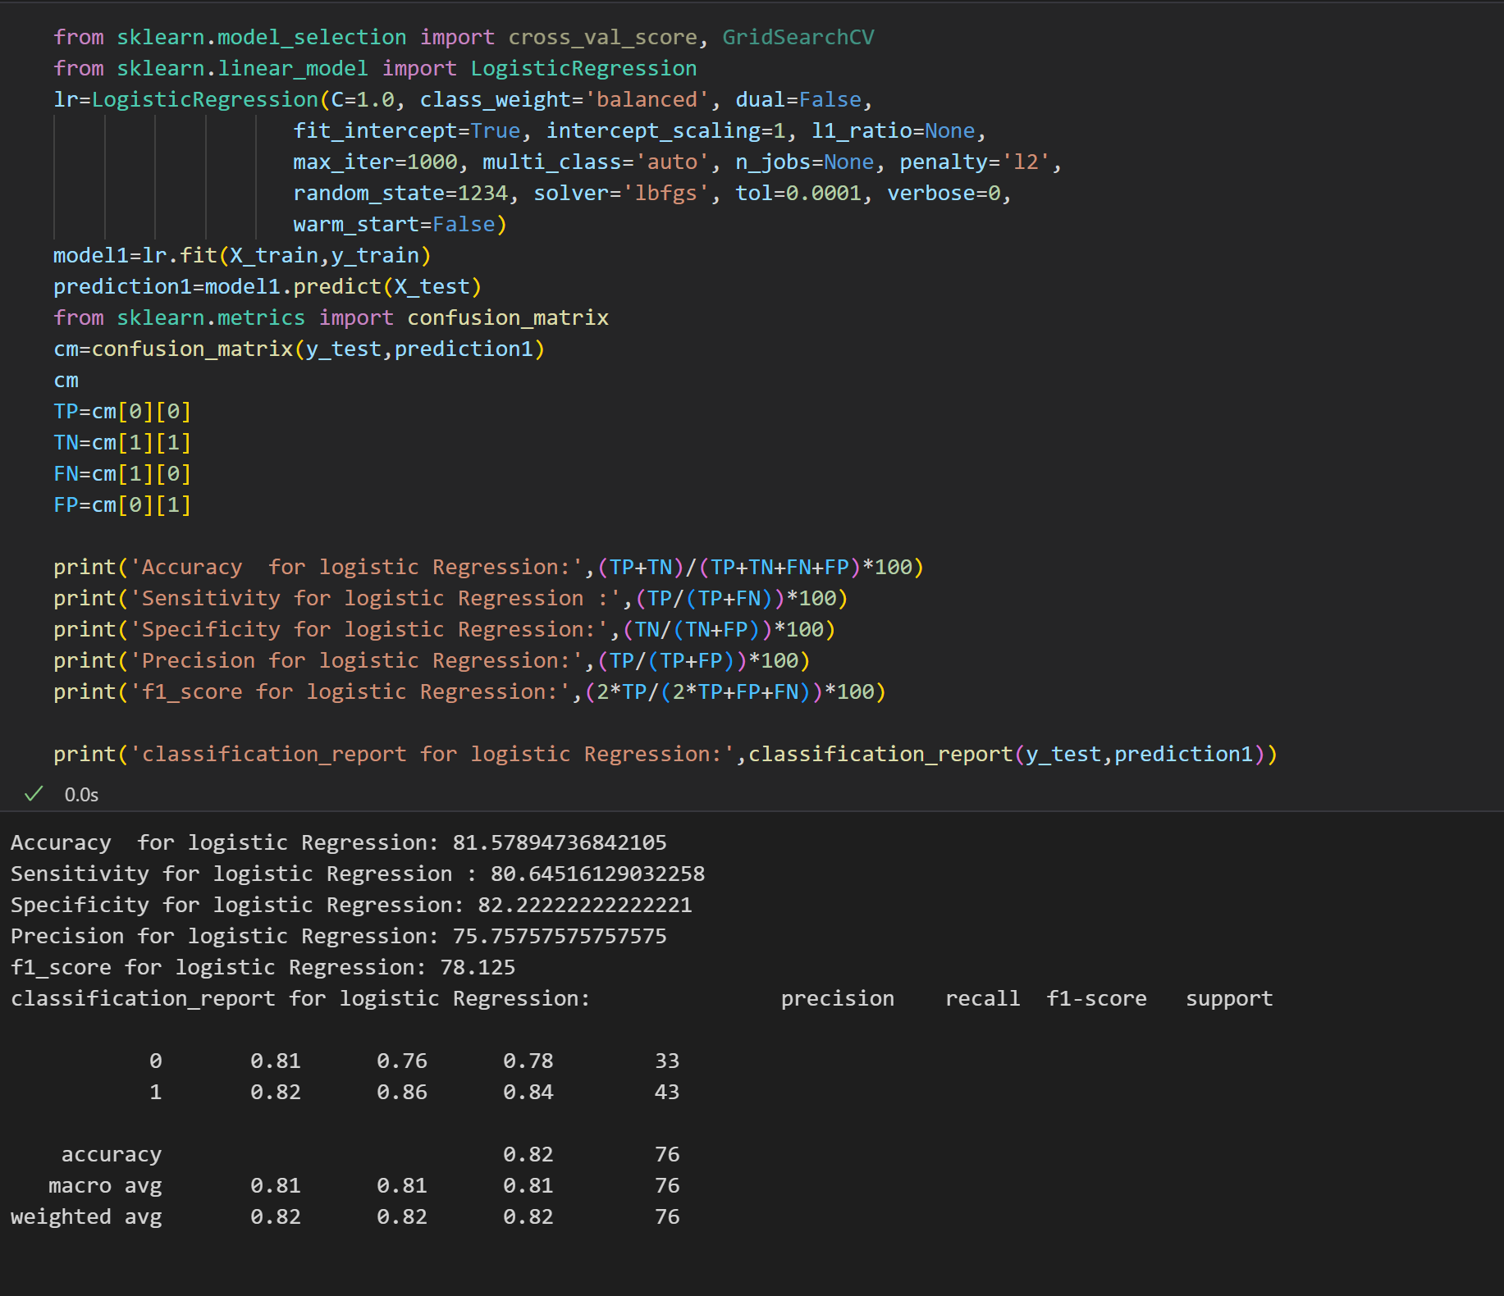
Results
LOGISTIC REGRESSION MODEL:

Slide 11
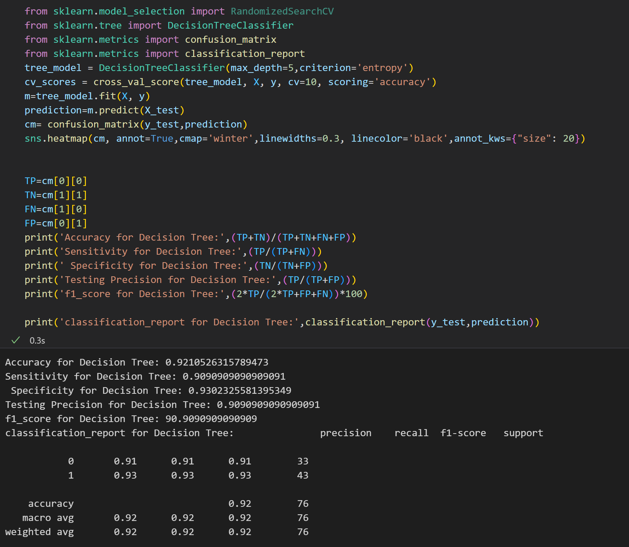
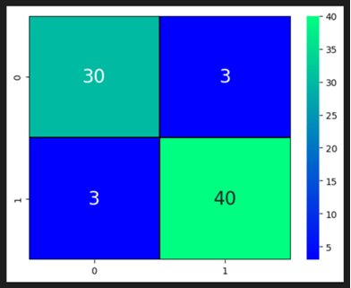
Results
DECISION TREE:

Slide 12
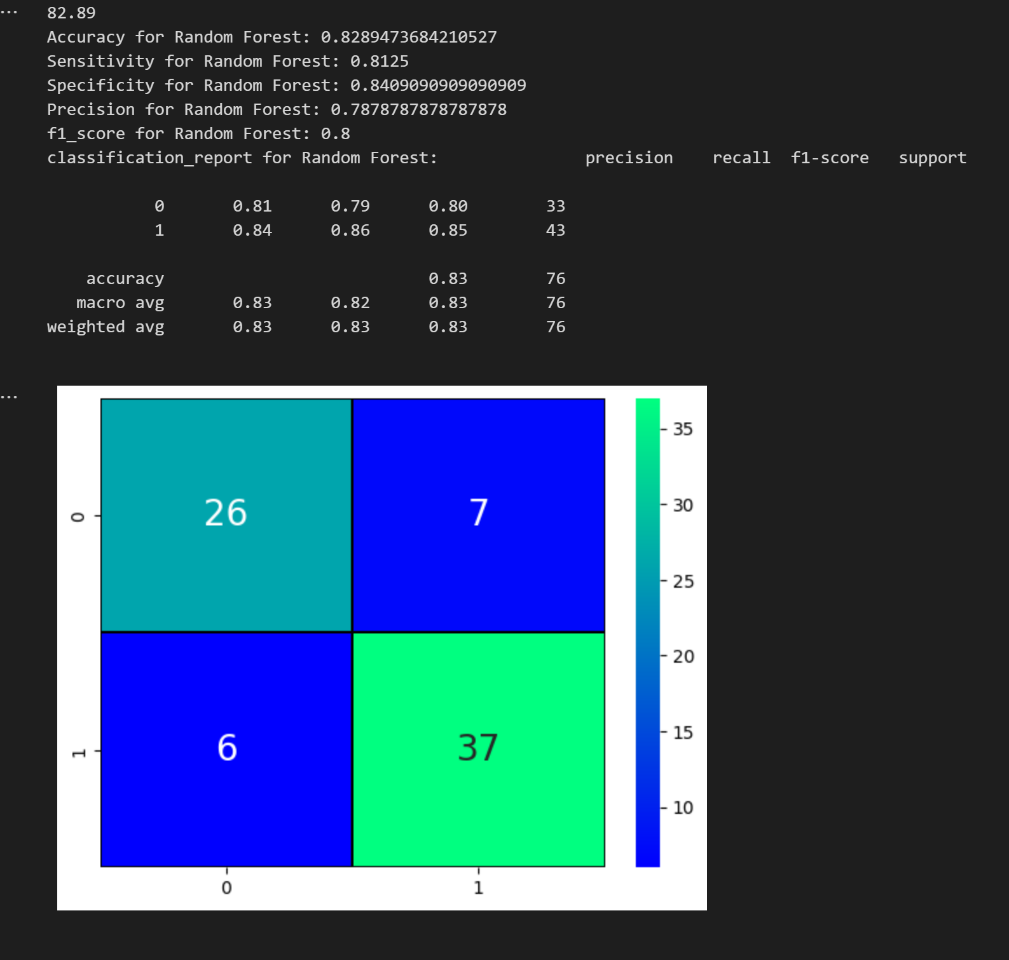
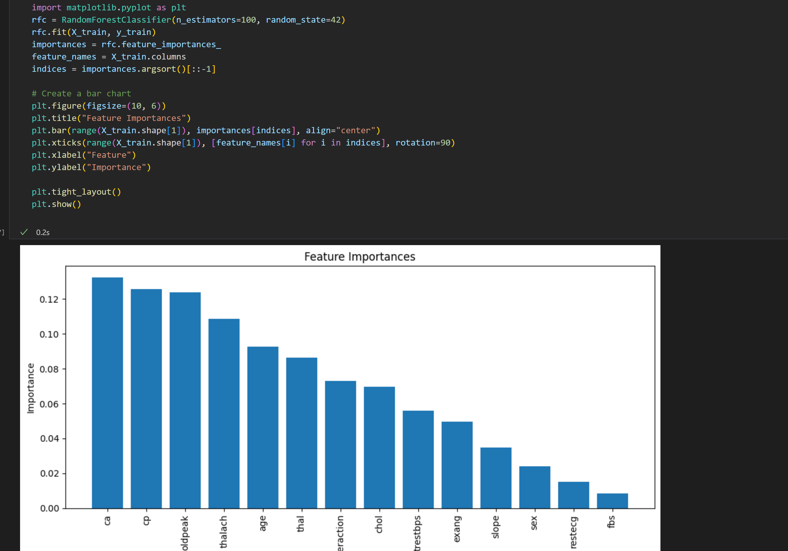
Results
RANDOM FOREST:

Slide 13
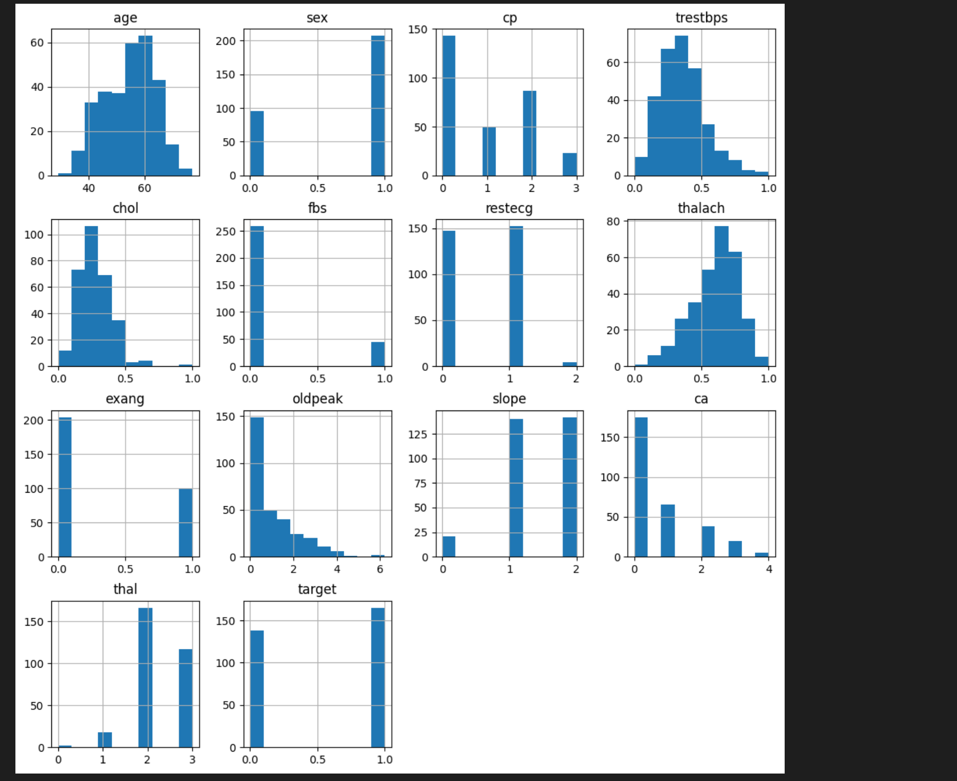
Results
DATA VISUALIZATIONS:

Slide 14
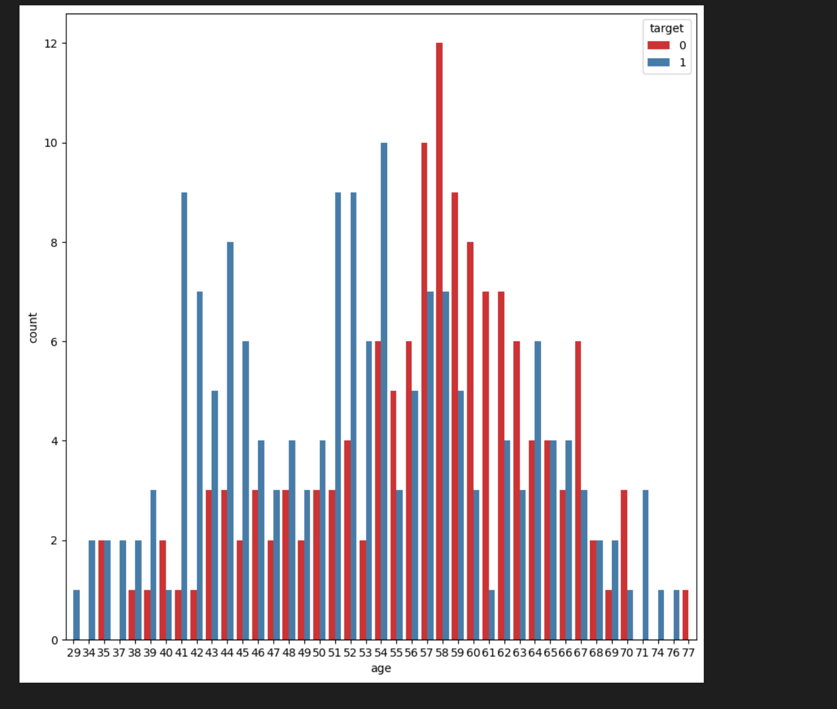
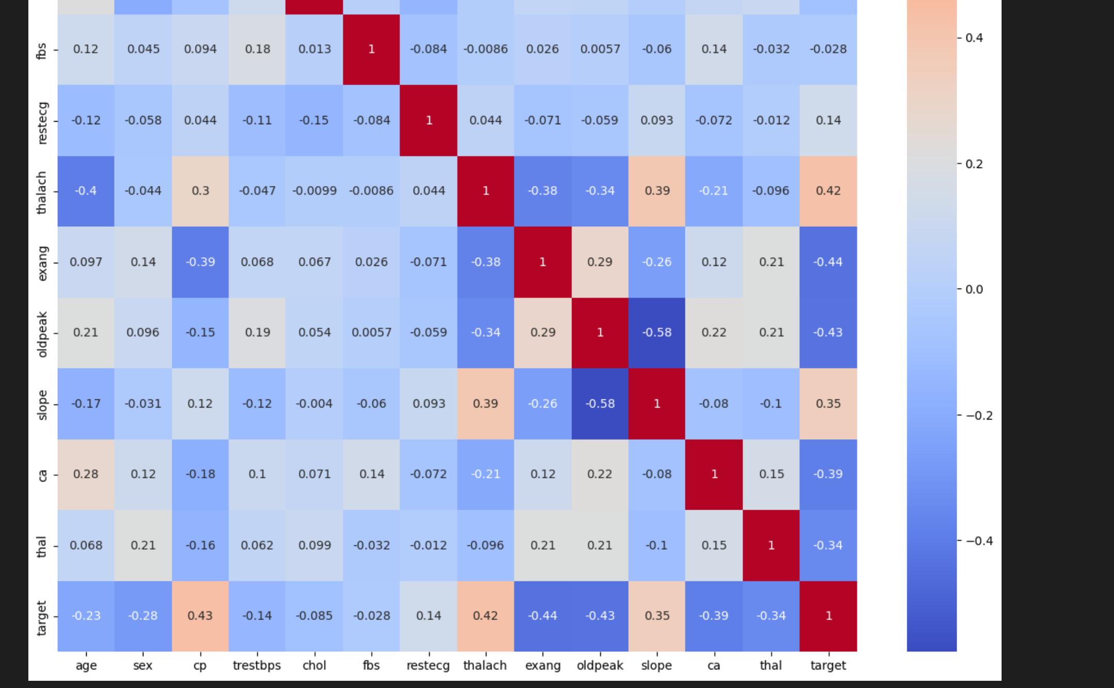
Results
DATA VISUALIZATIONS:

Slide 15
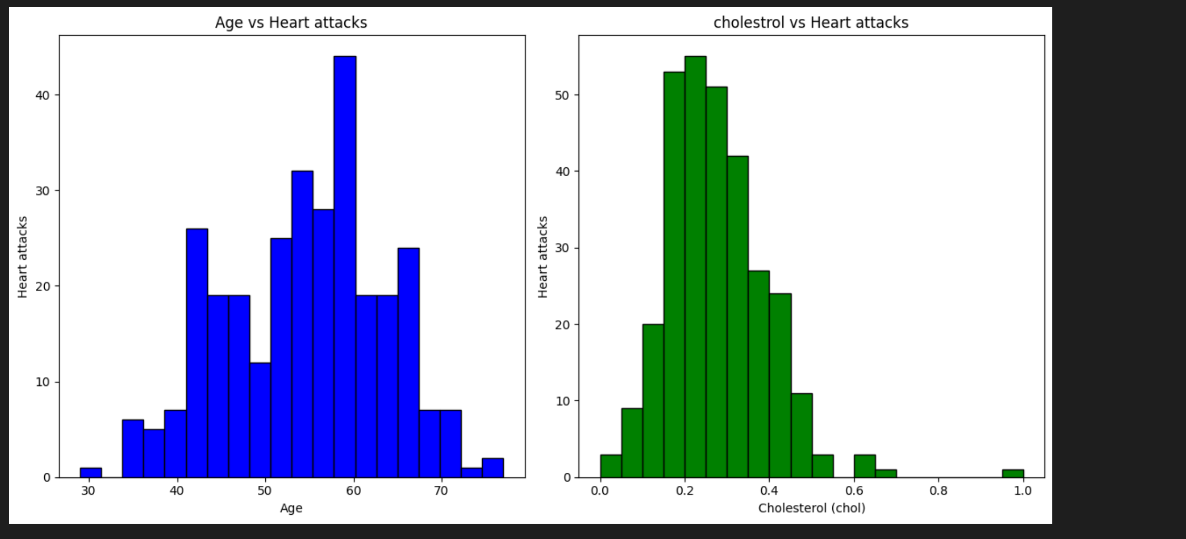
Result Comparison
DATA VISUALIZATIONS:

Slide 16
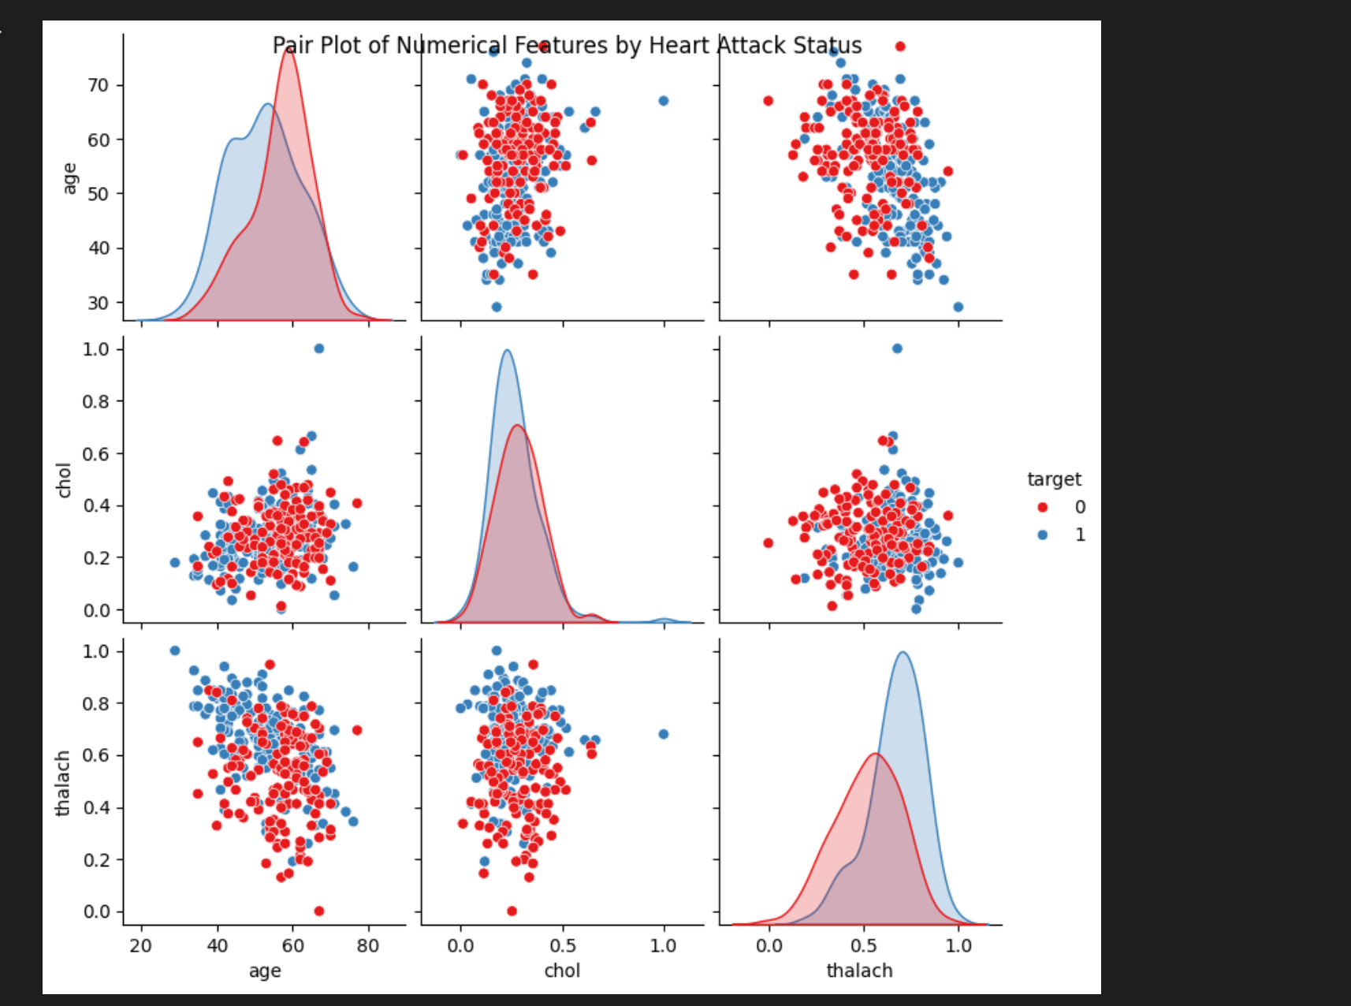
Results
DATA VISUALIZATIONS:

Slide 17
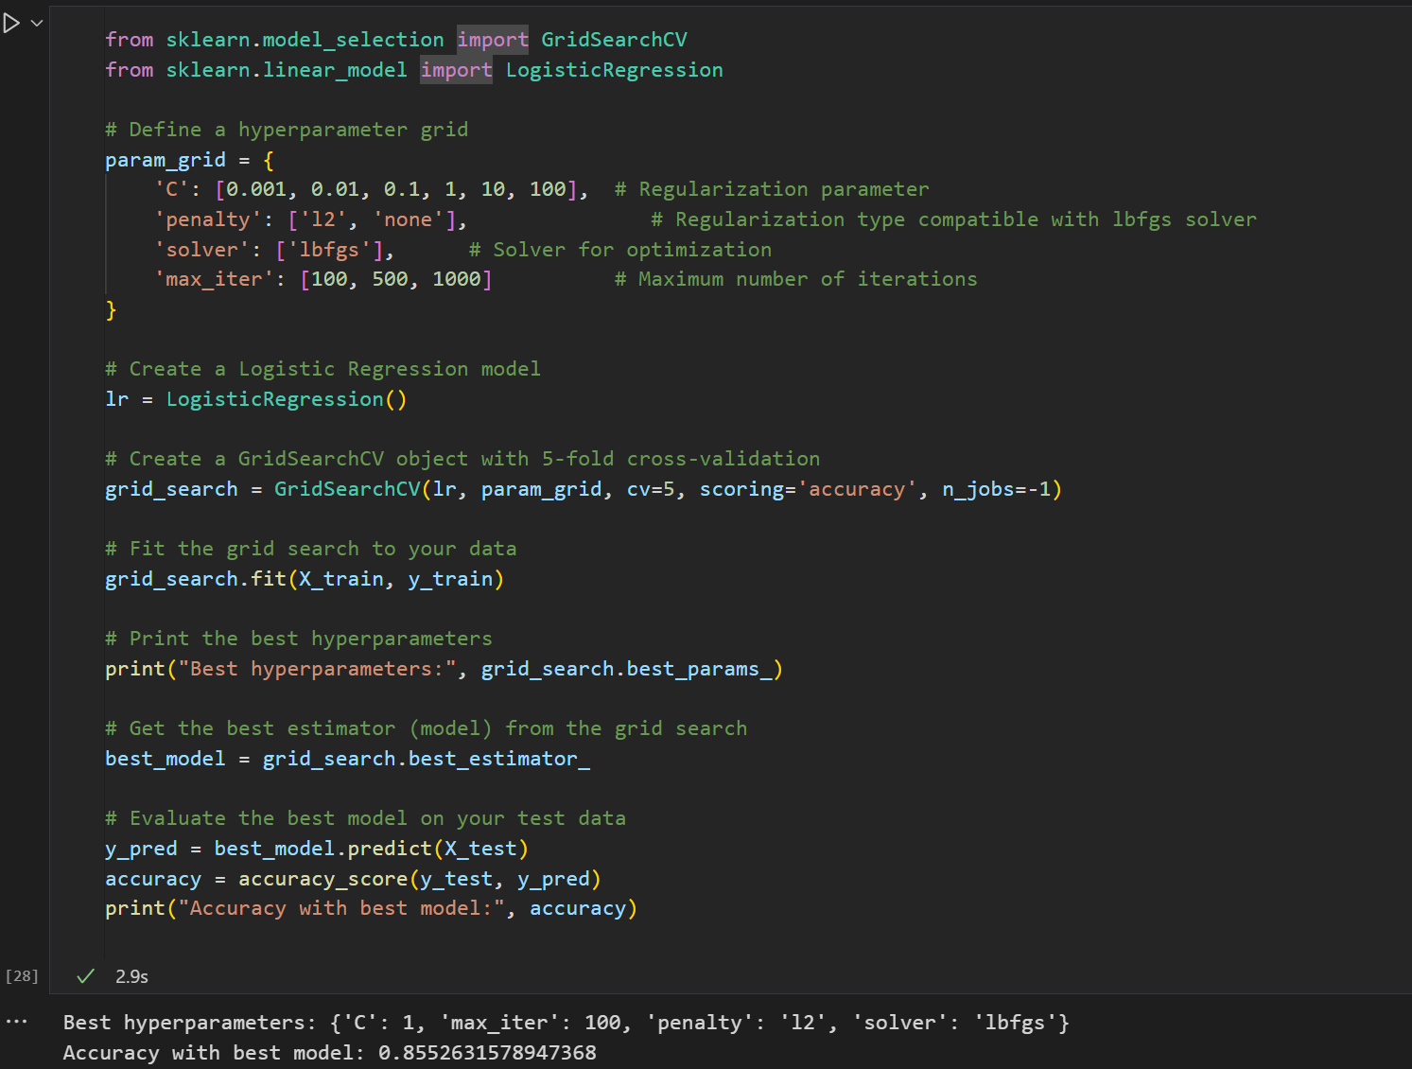
Results
HYPERPARAMETER TUNING:

Slide 18
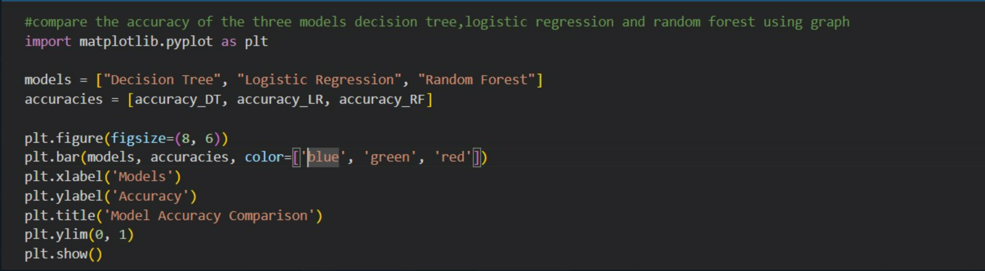
Review-1 Final Comparison

Slide 19
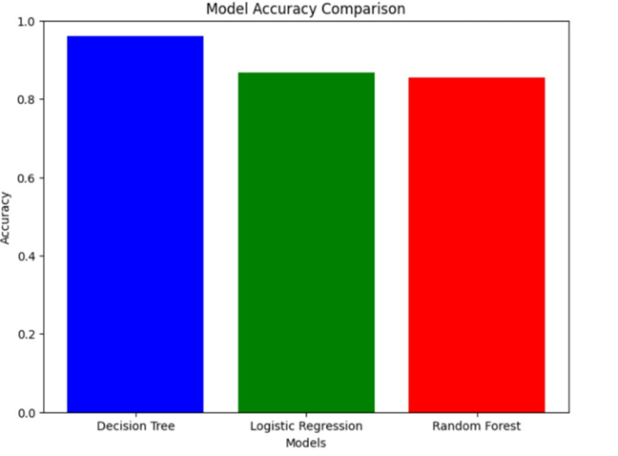
Review-1 Final Comparison

Slide 20
Review-2
Implementation:
Probabilistic model, Unsupervised model, Ensemble model, Dimensionality reduction
Analysis :
Visualization, Hyperparameter Tuning, Error-Loss curves, Performance Metrics

Slide 21
Supervised Models
LOGISTIC REGRESSION | DECISION TREE | INFERENCES
Initialize Parameters: Set initial values for coefficients (weights) and bias. Hypothesis Function: Compute the weighted sum of input features plus bias and pass it through the logistic function (sigmoid) to get the predicted probability. Loss Function: Calculate the logistic loss (cross-entropy) between the predicted probability and the actual label. Gradient Descent: Update coefficients and bias in the opposite direction of the gradient of the loss function with respect to the parameters, scaled by a learning rate. Repeat: Iterate steps 2-4 until convergence or a predefined number of iterations. This iterative process minimizes the difference between predicted probabilities and actual labels, fine-tuning the model for better classification performance. | Splitting Criteria: Choose a feature and a corresponding threshold to split the dataset into subsets based on a criterion (e.g., Gini impurity or information gain). Create Node: Create a tree node representing the split, storing the chosen feature and threshold. Recursive Splitting: Recursively apply steps 1-2 to each subset, creating child nodes until a stopping condition is met (e.g., maximum depth or minimum samples per leaf). Leaf Nodes: Assign a class label to each terminal node (leaf) based on the majority class of the instances in that node. Prediction: Traverse the tree from the root to a leaf, making predictions based on the assigned class label of the reached leaf. This process results in a tree structure that recursively divides the data based on feature values, forming decision rules for classification. | Logistic Regression is suitable for linear problems, provides probabilities, and is interpretable, but may struggle with non-linear data and is sensitive to outliers. Decision Trees are flexible, handle non-linear relationships well, and provide feature importance, but are prone to overfitting and might not generalize as effectively on some datasets. Regularization techniques and ensemble methods (e.g., Random Forests) are often employed to mitigate overfitting in Decision Trees.

Slide 22
Supervised Models
SUPPORT VECTOR MACHINE | RANDOM FORESTS | INFERENCES
Objective: SVM aims to find a hyperplane that best separates data into different classes while maximizing the margin between the classes. Kernel Trick: Utilizes a kernel function to implicitly map data into a higher-dimensional space, enabling the identification of complex, non-linear decision boundaries. Margin Optimization: Seeks to maximize the margin between support vectors (data points near the decision boundary) for better generalization to unseen data. Regularization: Balances the goal of maximizing the margin with the penalty for misclassifying data points, controlled by a regularization parameter (C). Prediction: Classifies new instances based on their position relative to the decision boundary, considering the side of the hyperplane they fall on. | Ensemble Method: Random Forest is an ensemble learning method that constructs a multitude of decision trees during training. Bootstrap Sampling: Randomly selects subsets of the training data with replacement (bootstrap samples) for each tree to promote diversity among the trees. Feature Randomization: Randomly selects a subset of features at each split in each tree, reducing correlation between trees and enhancing generalization. Decision Trees: Each tree is trained on a different subset of data and features, and predictions are made by averaging (regression) or voting (classification) over all trees. Bagging and Averaging: The final prediction is an aggregation of individual tree predictions, leading to improved accuracy and robustness against overfitting compared to individual decision trees. | Dataset Size: SVM may be more suitable for smaller datasets, while Random Forest can handle larger datasets efficiently. Interpretability: SVM decision boundaries may be more challenging to interpret compared to Random Forest, which provides insights into feature importance. Computational Cost: SVM, especially with non-linear kernels, can be computationally expensive, whereas Random Forest parallelizes the training of individual trees, making it more scalable. Task Type: Choose SVM for tasks where maximizing the margin between classes is crucial, and Random Forest for tasks that benefit from the aggregation of multiple decision trees, especially in scenarios with complex interactions among features.

Slide 23
Supervised Models
K NEAREST NEIGHBORS | GAUSSIAN NAIVE BAYES | INFERENCES
Training: Store all training examples. Input: Receive a new instance to classify. Distance Calculation: Compute the distance between the new instance and all stored training examples (commonly using Euclidean distance). Nearest Neighbors: Identify the k training instances with the smallest distances to the new instance. Majority Vote (for Classification): For classification, assign the class label that is most frequent among the k nearest neighbors. Weighted Average (for Regression): For regression, predict the average value of the target variable among the k nearest neighbors, weighted by their distances. The k-NN algorithm classifies or predicts based on the majority or average of the k nearest neighbors in the feature space. | Training: - Compute the mean and standard deviation for each feature in each class. - Calculate the prior probability of each class based on the training set. Input: - Receive a new instance with feature values. Likelihood Calculation: - For each feature in the new instance and for each class, calculate the probability density function (PDF) using the Gaussian (normal) distribution formula. Posterior Probability: - Multiply the prior probability of each class by the product of the likelihoods for each feature. Prediction: - Assign the class with the highest posterior probability as the predicted class for the new instance. Gaussian Naive Bayes assumes that the features within each class are normally distributed, and it leverages Bayes' theorem to compute posterior probabilities for each class given the observed features. | Data Characteristics: k-NN is suitable for datasets with complex decision boundaries, while Gaussian Naive Bayes is effective when independence assumptions hold. Scalability: For large datasets, Gaussian Naive Bayes may be more scalable due to its faster training process. Model Interpretability: Gaussian Naive Bayes provides explicit probabilities and is often more interpretable than k-NN. The choice between these algorithms depends on the specific characteristics of the data and the requirements of the problem at hand.

Slide 24
Probabilistic Models
GAUSSIAN NAIVE BAYES | GAUSSIAN MIXTURE MODEL | INFERENCES
Training: - Compute the mean and standard deviation for each feature in each class. - Calculate the prior probability of each class based on the training set. Input: - Receive a new instance with feature values. Likelihood Calculation: - For each feature in the new instance and for each class, calculate the probability density function (PDF) using the Gaussian (normal) distribution formula. Posterior Probability: - Multiply the prior probability of each class by the product of the likelihoods for each feature. Prediction: - Assign the class with the highest posterior probability as the predicted class for the new instance. Gaussian Naive Bayes assumes that the features within each class are normally distributed, and it leverages Bayes' theorem to compute posterior probabilities for each class given the observed features. | Initialization: Start by initializing the model parameters, including the number of components (Gaussians), mean vectors, covariance matrices, and component weights. Expectation-Maximization (EM) Algorithm: - Expectation Step (E-step): Compute the probability (responsibility) of each data point belonging to each Gaussian component based on the current parameter estimates using the multivariate Gaussian distribution. Maximization Step (M-step): Update the parameters (mean, covariance, and weights) by maximizing the expected log-likelihood obtained from the E-step. Convergence Check: Repeat the E-step and M-step until convergence is achieved, typically by checking for small changes in the log-likelihood or the model parameters. Prediction: Once the model converges, use the learned parameters to make predictions by assigning each data point to the Gaussian component with the highest probability. GMM is a probabilistic model that represents the data as a mixture of several Gaussian distributions. It is commonly used for clustering and density estimation tasks. | Gaussian Mixture Model (GMM): Flexible probabilistic model for clustering and density estimation. Captures complex data distributions using a mixture of Gaussian components, provides uncertainty estimates. Sensitive to initialization, may converge to local optima. Gaussian Naive Bayes (GNB): Simple and efficient classification algorithm, assuming feature independence. Fast and suitable for high-dimensional datasets, performs well in text classification. Relies on the assumption of feature independence and Gaussian distribution, may not handle complex dependencies well. Choosing between GMM and GNB depends on the specific characteristics of the data and the goals of the analysis. GMM is more versatile for capturing intricate patterns, while GNB is efficient and effective for certain types of classification tasks, particularly when the independence assumption holds.

Slide 25
Probabilistic & Unsupervised models
GAUSSIAN MIXTURE MODEL | HIERARCHICAL CLUSTERING | INFERENCES
Initialization: Start by initializing the model parameters, including the number of components (Gaussians), mean vectors, covariance matrices, and component weights. Expectation-Maximization (EM) Algorithm: - Expectation Step (E-step): Compute the probability (responsibility) of each data point belonging to each Gaussian component based on the current parameter estimates using the multivariate Gaussian distribution. Maximization Step (M-step): Update the parameters (mean, covariance, and weights) by maximizing the expected log-likelihood obtained from the E-step. Convergence Check: Repeat the E-step and M-step until convergence is achieved, typically by checking for small changes in the log-likelihood or the model parameters. Prediction: Once the model converges, use the learned parameters to make predictions by assigning each data point to the Gaussian component with the highest probability. | Hierarchical clustering is a technique in cluster analysis that builds a hierarchy of clusters. It's a partitional clustering method, meaning it divides the dataset into groups or clusters. The key idea is to create a tree of clusters, known as a dendrogram, where the root of the tree is a single cluster containing all data points, and the leaves are individual data points. The choice of linkage method, which determines how the distance between clusters is calculated, is a crucial aspect of hierarchical clustering. Common linkage methods include: Single Linkage: Based on the minimum pairwise distance between members of two clusters. Complete Linkage: Based on the maximum pairwise distance between members of two clusters. Average Linkage: Based on the average pairwise distance between members of two clusters. Ward's Linkage: Minimizes the increase in variance within clusters when merging. | Nature: Hierarchical Clustering: Agglomerative or divisive, forming a tree structure based on pairwise distances. Gaussian Mixture Models (GMM): Probabilistic, assuming data is generated from a mixture of Gaussian distributions. Cluster Structure: Hierarchical Clustering: Hierarchy represented in a dendrogram, allowing for multi-level granularity. GMM: Allows soft assignment, expressing uncertainty in data point cluster membership. Assumptions: Hierarchical Clustering: Distance-based, no specific assumptions about cluster shapes. GMM: Assumes normal distribution within clusters, accommodating more complex shapes. Data Structure: Hierarchical Clustering: Suitable for data with hierarchical organization or when a hierarchy of clusters is desired. GMM: Useful when clusters have complex shapes, and soft assignments are valuable.

Slide 26
Unsupervised Models
K - MEANS CLUSTERING | GAUSSIAN MIXTURE MODEL | INFERENCES
Initialization: Start by randomly selecting K initial cluster centroids, where K is the pre-defined number of clusters. Assignment: Assign each data point to the cluster whose centroid is closest (typically using Euclidean distance). Update Centroids: Recalculate the centroids of each cluster by taking the mean of all data points assigned to that cluster. Repeat: Iterate between the assignment and update steps until convergence, i.e., when the centroids no longer change significantly or a maximum number of iterations is reached. Final Clustering: The algorithm converges to a set of centroids and assigns each data point to a cluster based on the final centroids. K-means is an iterative algorithm that aims to partition a dataset into K clusters, minimizing the sum of squared distances between data points and their assigned cluster centroids. The resulting clusters are often used for data segmentation and analysis. | Initialization: Start by initializing the model parameters, including the number of components (Gaussians), mean vectors, covariance matrices, and component weights. Expectation-Maximization (EM) Algorithm: - Expectation Step (E-step): Compute the probability (responsibility) of each data point belonging to each Gaussian component based on the current parameter estimates using the multivariate Gaussian distribution. Maximization Step (M-step): Update the parameters (mean, covariance, and weights) by maximizing the expected log-likelihood obtained from the E-step. Convergence Check: Repeat the E-step and M-step until convergence is achieved, typically by checking for small changes in the log-likelihood or the model parameters. Prediction: Once the model converges, use the learned parameters to make predictions by assigning each data point to the Gaussian component with the highest probability. GMM is a probabilistic model that represents the data as a mixture of several Gaussian distributions. It is commonly used for clustering and density estimation tasks. | K-means: Provides clear, distinct clusters suitable for tasks with well-defined groupings. GMM: More flexible, accommodating complex data distributions and instances where data points may belong to multiple clusters. Ideal for tasks requiring a probabilistic and nuanced approach.

Slide 27
Ensemble models
RANDOM FORESTS | ADA BOOST | INFERENCES
Ensemble Method: Random Forest is an ensemble learning method that constructs a multitude of decision trees during training. Bootstrap Sampling: Randomly selects subsets of the training data with replacement (bootstrap samples) for each tree to promote diversity among the trees. Feature Randomization: Randomly selects a subset of features at each split in each tree, reducing correlation between trees and enhancing generalization. Decision Trees: Each tree is trained on a different subset of data and features, and predictions are made by averaging (regression) or voting (classification) over all trees. Bagging and Averaging: The final prediction is an aggregation of individual tree predictions, leading to improved accuracy and robustness against overfitting compared to individual decision trees. | Initialize Weights: Assign equal weights to all training samples. These weights represent the importance of each sample in the training process. Iterative Training: - For a predefined number of iterations (or until perfect predictions are achieved): Fit Weak Learner: - Train a weak learner (e.g., a decision tree with limited depth) on the training data. Update Weights: - Adjust the weights of the training samples to emphasize misclassified samples. This means that the algorithm focuses more on the previously misclassified samples in the next iteration. Combine Weak Learners: - Assign a weight to each weak learner based on its performance. The better the weak learner performs, the higher its weight in the final prediction. Combine the weak learners' predictions by summing them with their respective weights to form the strong learner. Repeat: - Repeat steps 3-5 for the specified number of iterations or until perfect predictions are achieved. | Use Adaboost when: - Dealing with complex relationships and challenging instances. - Interpretability is a priority. - Adopting a sequential learning approach is beneficial. Use Random Forest when: - Handling high-dimensional data. - Emphasizing robustness and reducing overfitting. - Capturing non-linear patterns is crucial. - Seeking a versatile algorithm across different datasets. Consider computational resources, dataset size, and tuning parameters for both algorithms. Empirical testing and cross-validation can guide the choice based on the specific characteristics and requirements of your data and problem.

Slide 28
Ensemble models
GRADIENT BOOSTING | XGBBOOST | INFERENCES
Gradient Boosting is an ensemble learning algorithm that combines multiple weak learners (typically decision trees) sequentially, where each tree corrects the errors of the previous ones. Initialization: Start with a simple model (e.g., a shallow tree) to predict the target. Compute Residuals: Calculate the difference between the actual and predicted values (residuals). Fit a Weak Learner: Train a new model (weak learner) on the residuals to capture the remaining errors. Update Predictions: Combine the predictions of all models by adding them together, adjusting the weights based on a learning rate. Repeat: Iteratively repeat steps 2-4 until a predefined number of trees is reached or no significant improvement is observed, creating a strong predictive model. | XGBoost (Extreme Gradient Boosting) is an advanced implementation of the gradient boosting algorithm, known for its speed and performance Objective Function: XGBoost minimizes a regularized objective function that combines a loss function (e.g., mean squared error for regression, log loss for classification) with a penalty term to control model complexity. Gradient and Hessian: It computes the first and second derivatives of the objective function with respect to the predicted values, enabling more efficient and accurate updates during training. Tree Ensemble Construction: XGBoost builds decision trees sequentially, using a greedy algorithm that selects the best split points based on the calculated gradients and Hessians. Regularization: The algorithm includes L1 and L2 regularization terms to control overfitting by penalizing the complexity of the model and encouraging sparsity in the feature space. Boosting: XGBoost combines the predictions of multiple trees by assigning weights to each tree based on its performance. The final prediction is the sum of the weighted tree predictions, adjusted by a learning rate. | Gradient Boosting and XGBoost are powerful ensemble learning techniques that iteratively combine weak learners to create robust models. Gradient Boosting is versatile, interpretable, and implemented in various libraries. XGBoost, an optimized version, adds efficiency, regularization, and handling of missing values, often outperforming traditional implementations. Both excel in capturing complex relationships, providing high predictive accuracy and robustness to outliers. However, XGBoost's speed, built-in features, and ease of tuning make it a popular choice, with careful consideration of computational resources. Overall, these methods are valuable for a wide range of tasks, offering a balance between interpretability and predictive performance.

Slide 29
Ensemble models
VOTING CLASSIFIER | STACKING | INFERENCES
A voting classifier is an ensemble machine learning algorithm that combines predictions from multiple individual classifiers. Each classifier provides a vote for a particular class, and the class with the majority of votes is chosen as the final prediction. This helps improve overall accuracy and robustness by leveraging diverse models Hard Voting: Each base classifier "votes" for a class, and the class with the majority of votes is chosen as the final prediction. It is a simple and often effective approach, especially when individual classifiers are diverse. Soft Voting: Instead of just counting votes, each classifier provides a probability estimate for each class. The final prediction is based on the weighted average of these probabilities, where the weights are often proportional to the classifier's confidence in its prediction. | Stacking, short for stacked generalization, is an ensemble learning technique that combines multiple models through a meta-model to improve predictive performance. Base Models: - Stacking involves training several diverse base models on the same dataset. These base models can be different algorithms or the same algorithm with different hyperparameters. Predictions as Features: - The predictions made by each base model on the input data are then used as features for the next level of the model. These predicted values become the input for the meta-model. Meta-Model: - A meta-model (or blender) is trained on the new dataset composed of the predictions from the base models. This meta-model learns to combine the predictions of the base models to make a final prediction. Hierarchical Structure: - Stacking introduces a hierarchical structure, where the base models form the first level, and the meta-model constitutes the second level. This structure allows the ensemble to capture complex relationships and patterns in the data. Improved Generalization: The meta-model helps to weigh the predictions of the base models, potentially mitigating the weaknesses of individual models. | Voting Classifier: When to Use: Use a voting classifier when you have multiple diverse base models. Suitable for situations where models have different strengths and weaknesses. Quick and easy to implement with minimal hyperparameter tuning. Stacking: When to Use: Consider stacking when you need a more advanced ensemble approach. Beneficial when base models offer complementary insights or have varying predictive strengths. Effective in handling complex relationships and patterns in the data. Requires more computational resources and careful model selection.

Slide 30
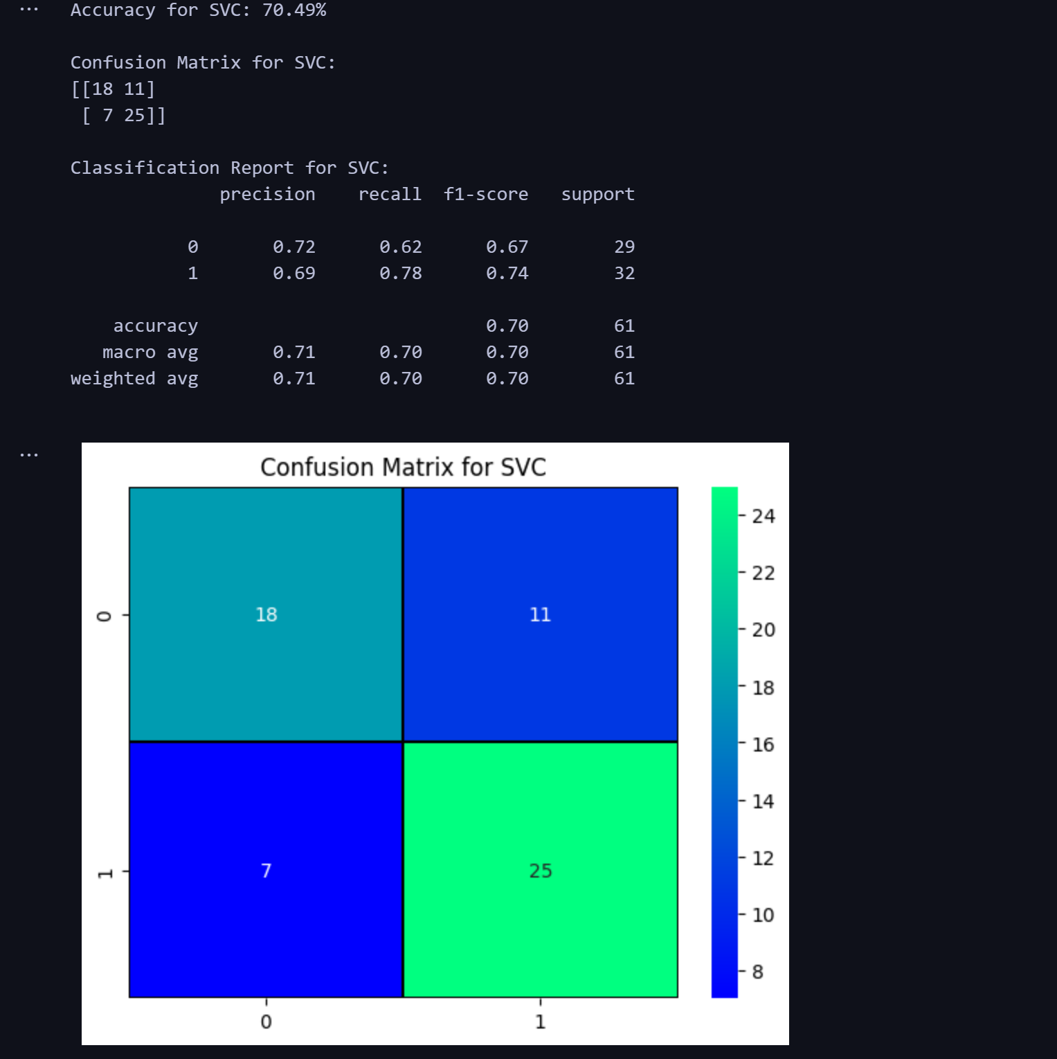
RESULTS
SUPPORT VECTOR MACHINE

Slide 31
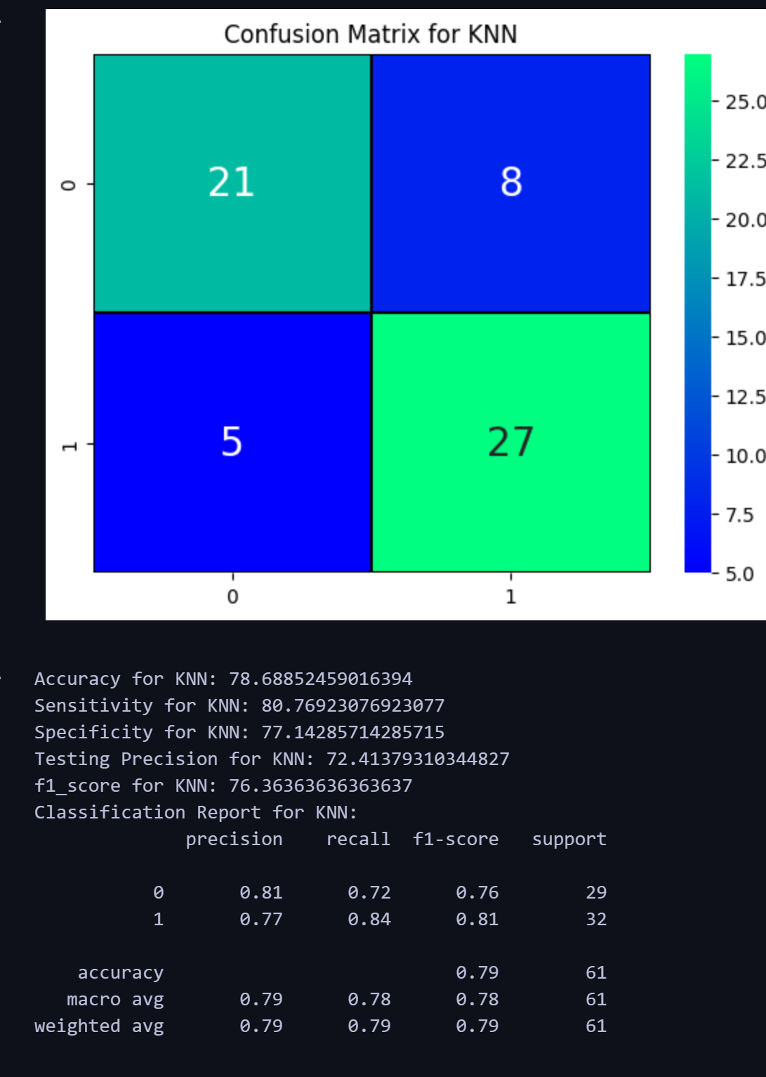
RESULTS
K NEAREST NEIGHBORS

Slide 32
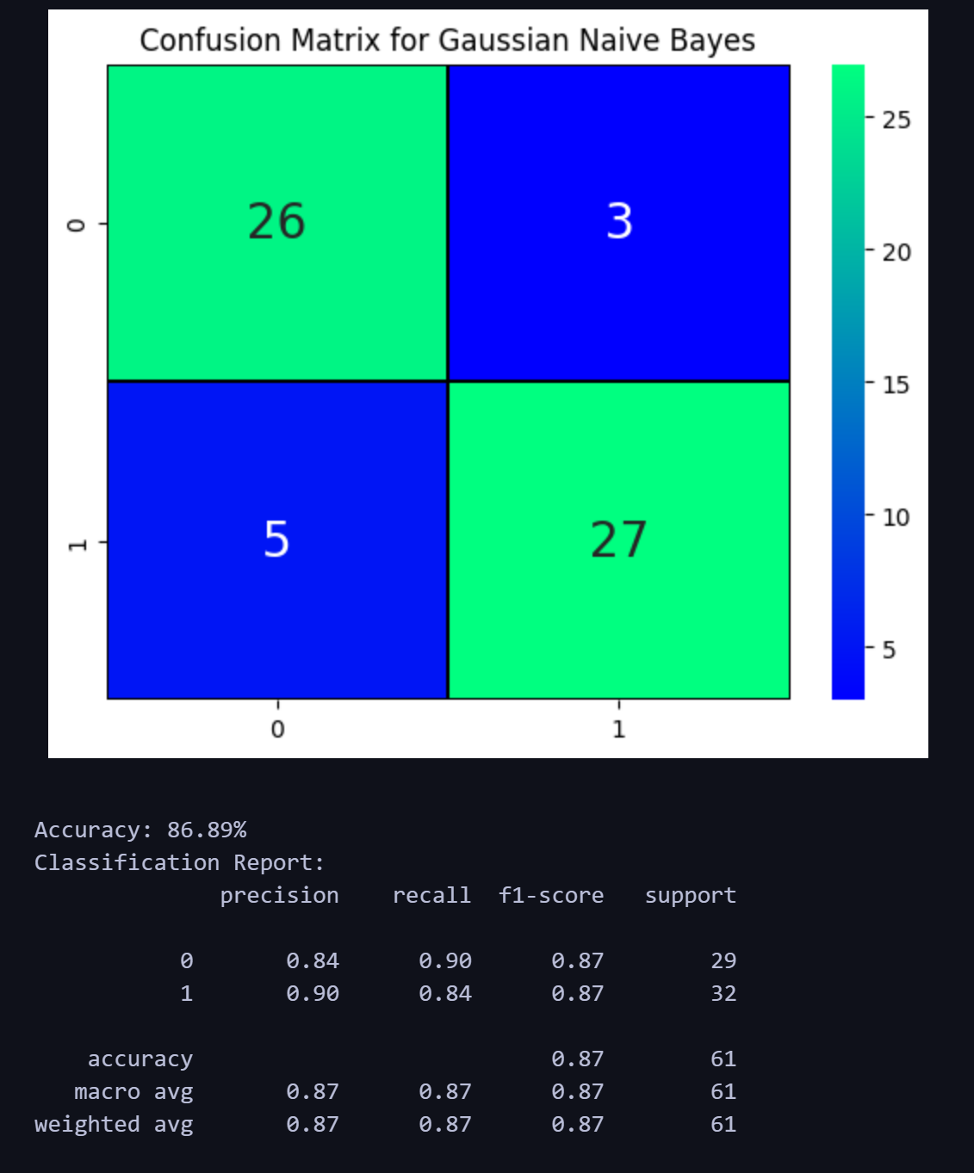
RESULTS
GAUSSIAN NAIVE BAYES

Slide 33
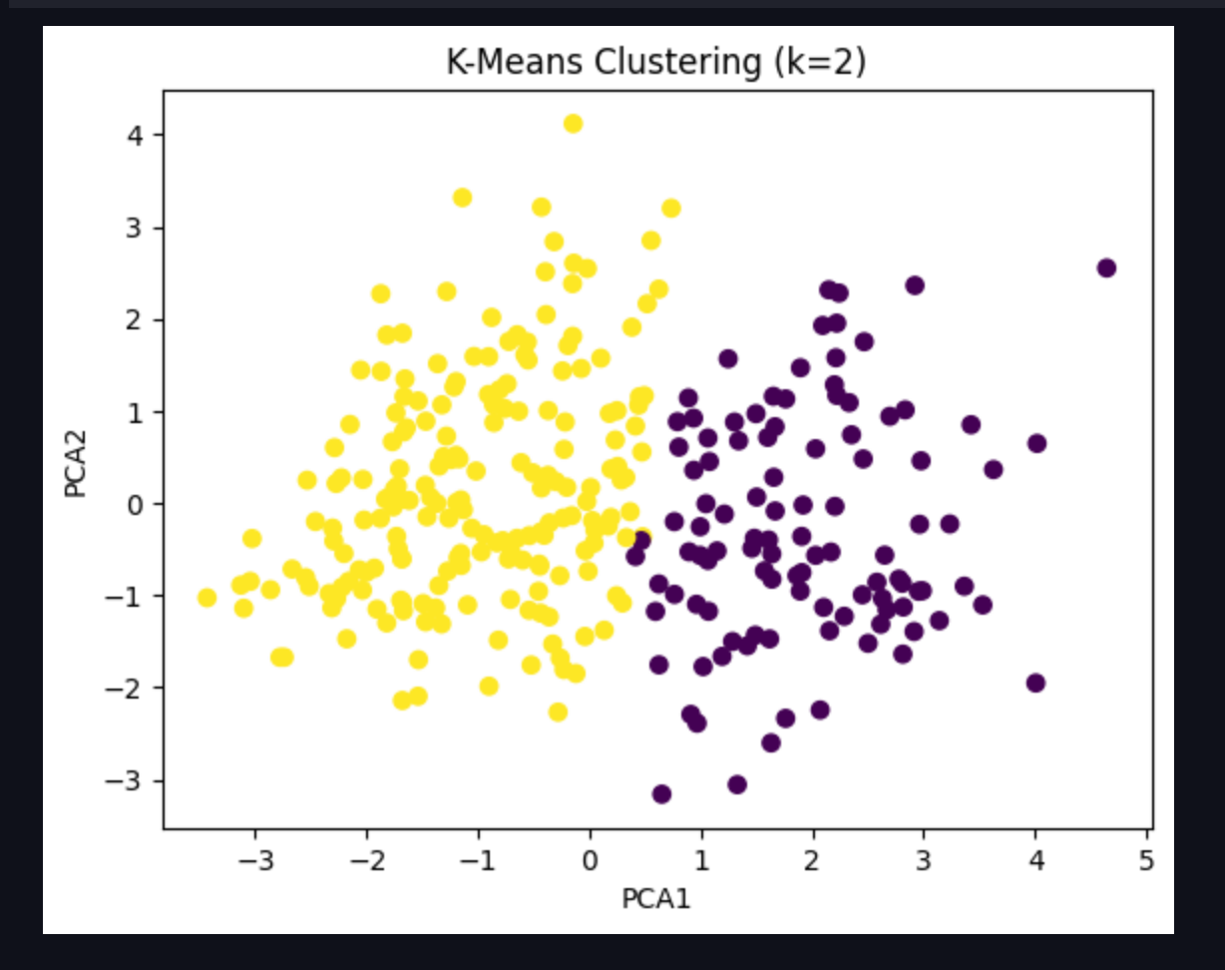
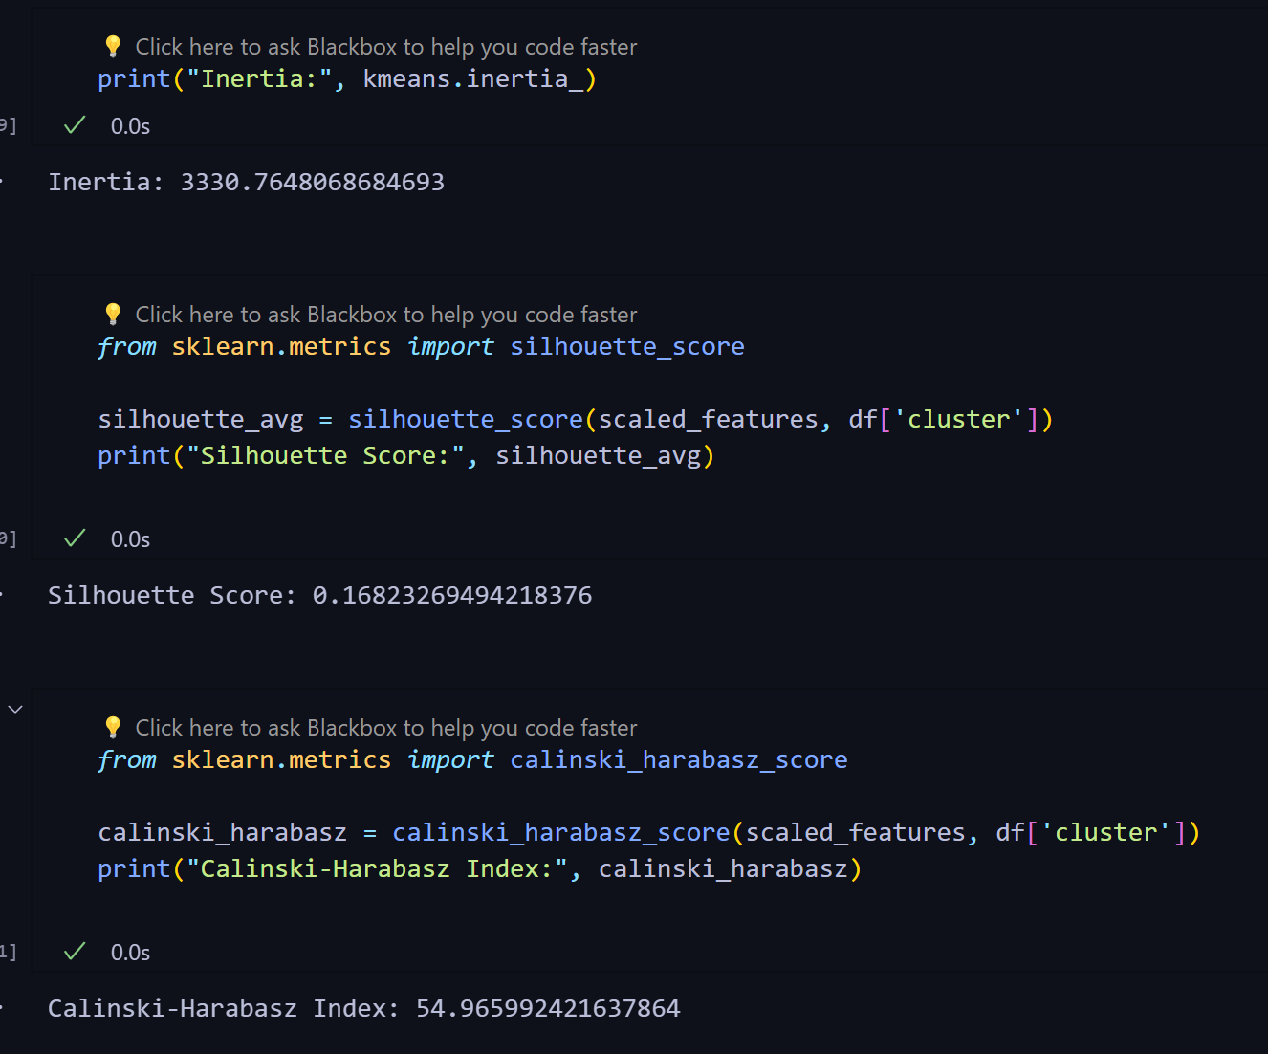
RESULTS
K - MEANS CLUSTERING

Slide 34
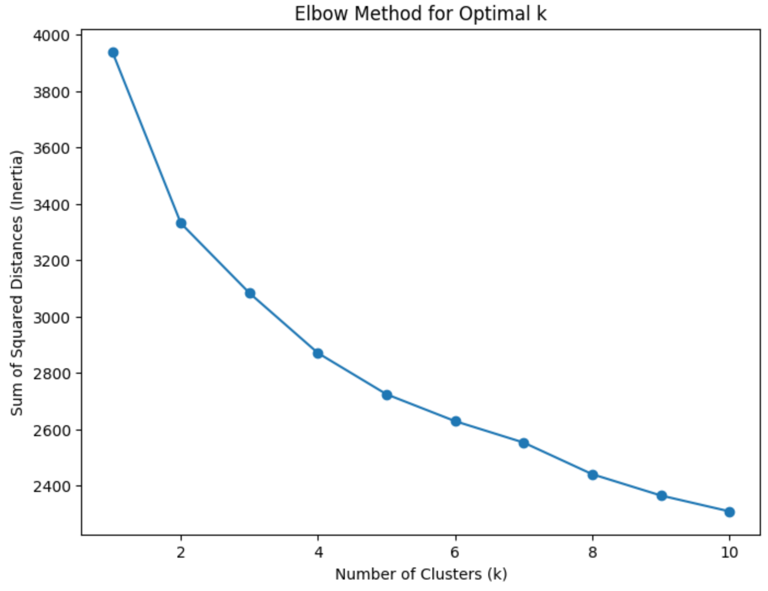

Slide 35
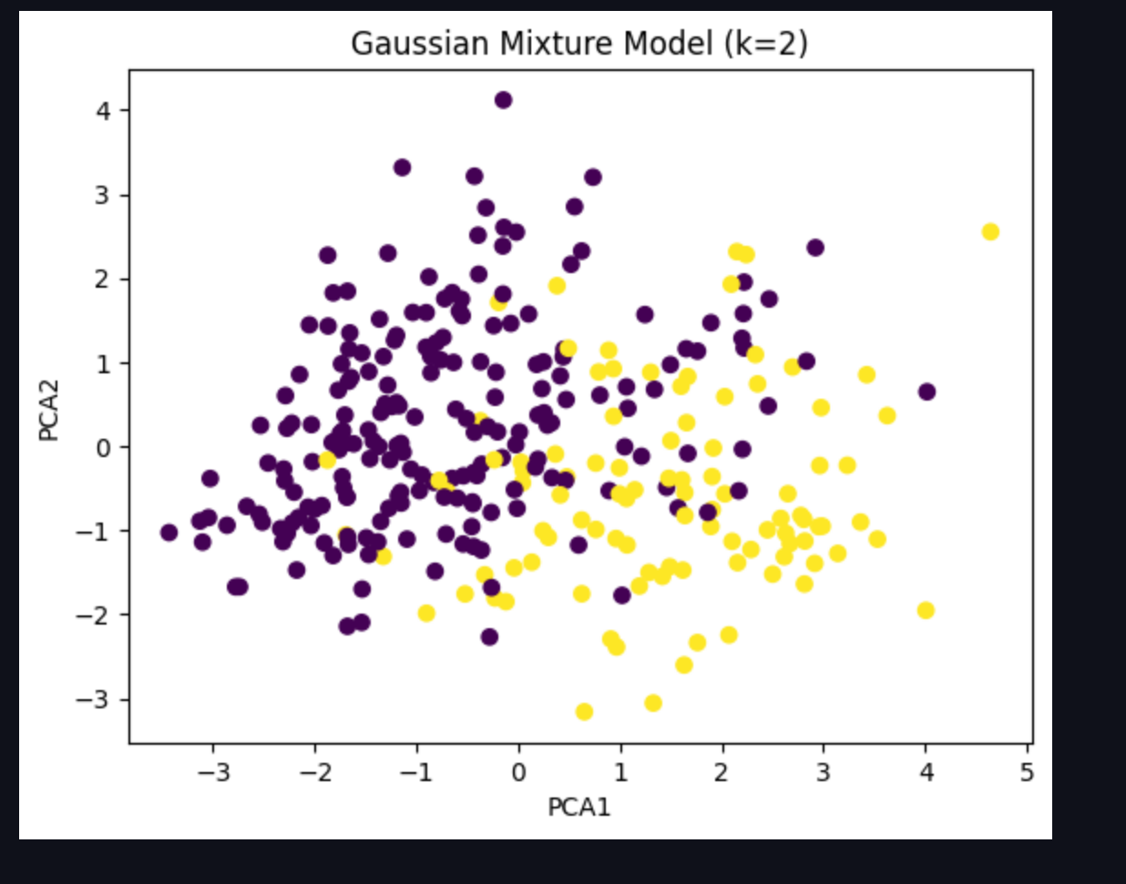
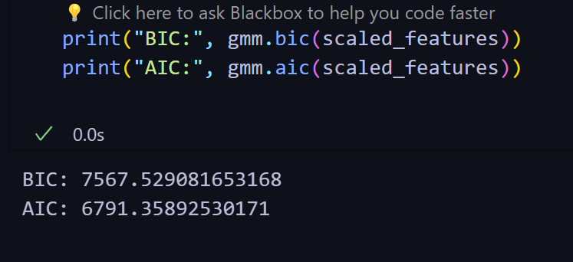
RESULTS
GAUSSIAN MIXTURE MODEL

Slide 36
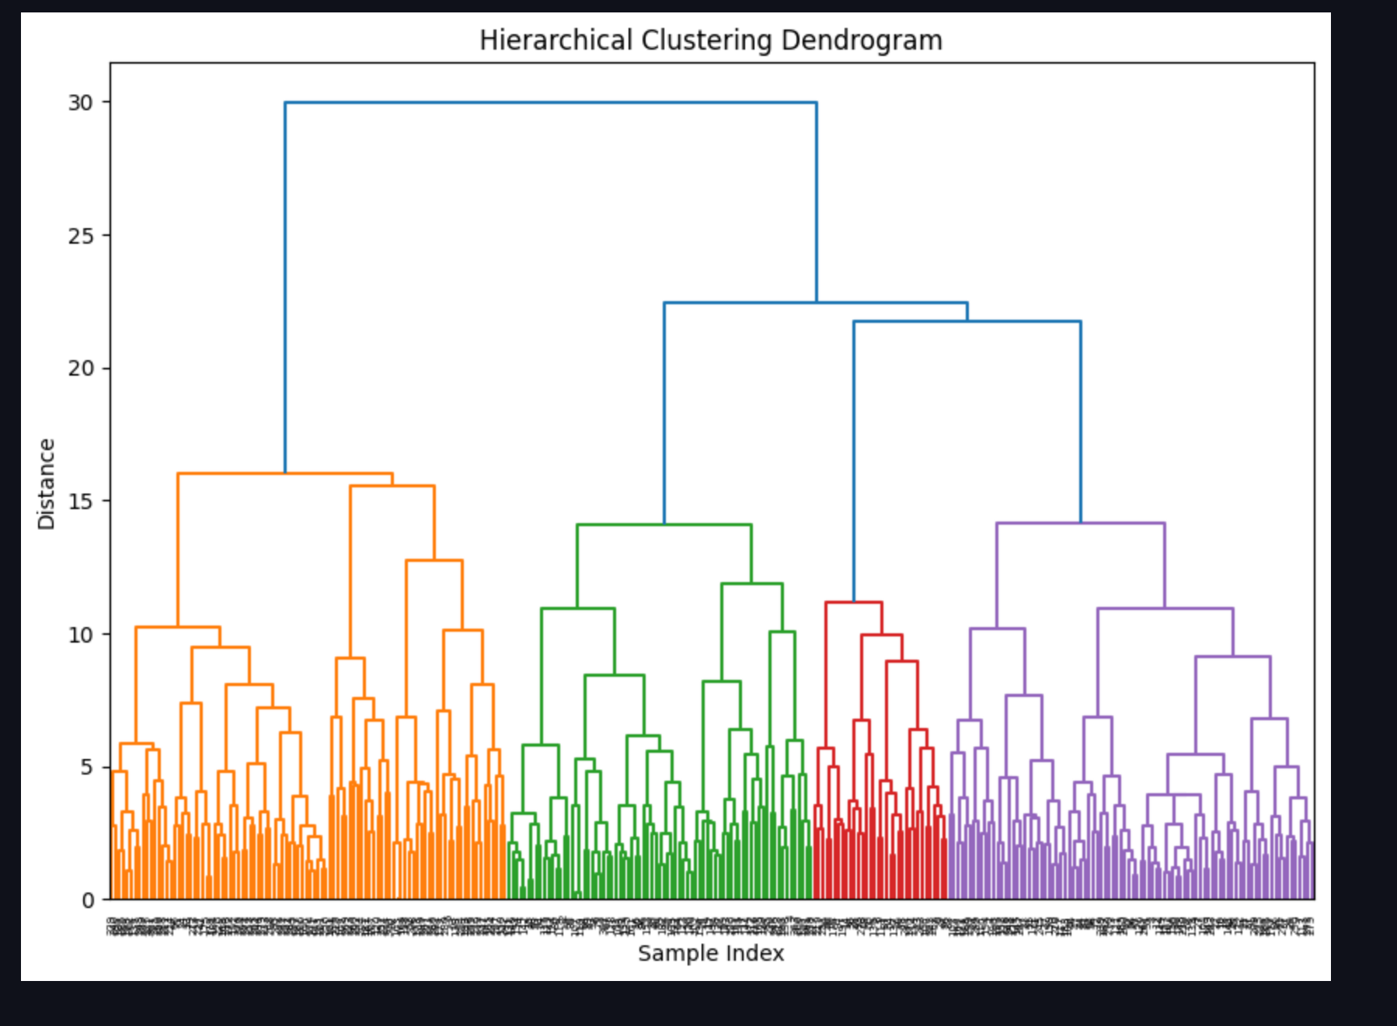
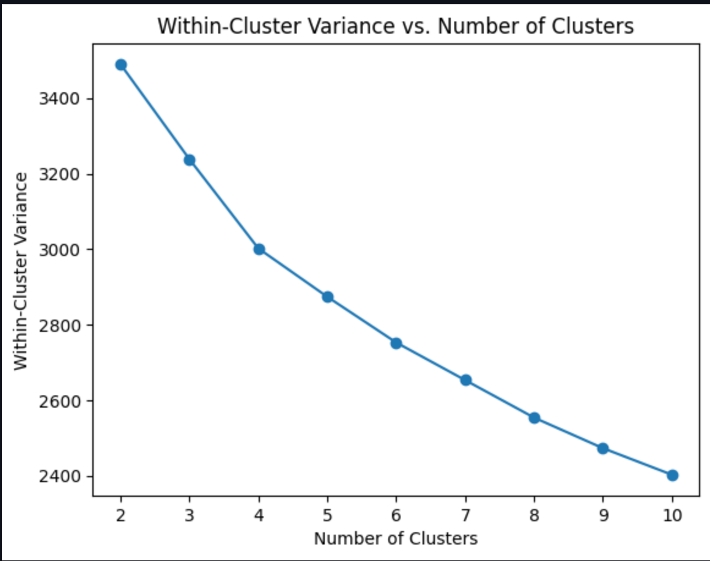
RESULTS
Hierarchical Clustering

Slide 37
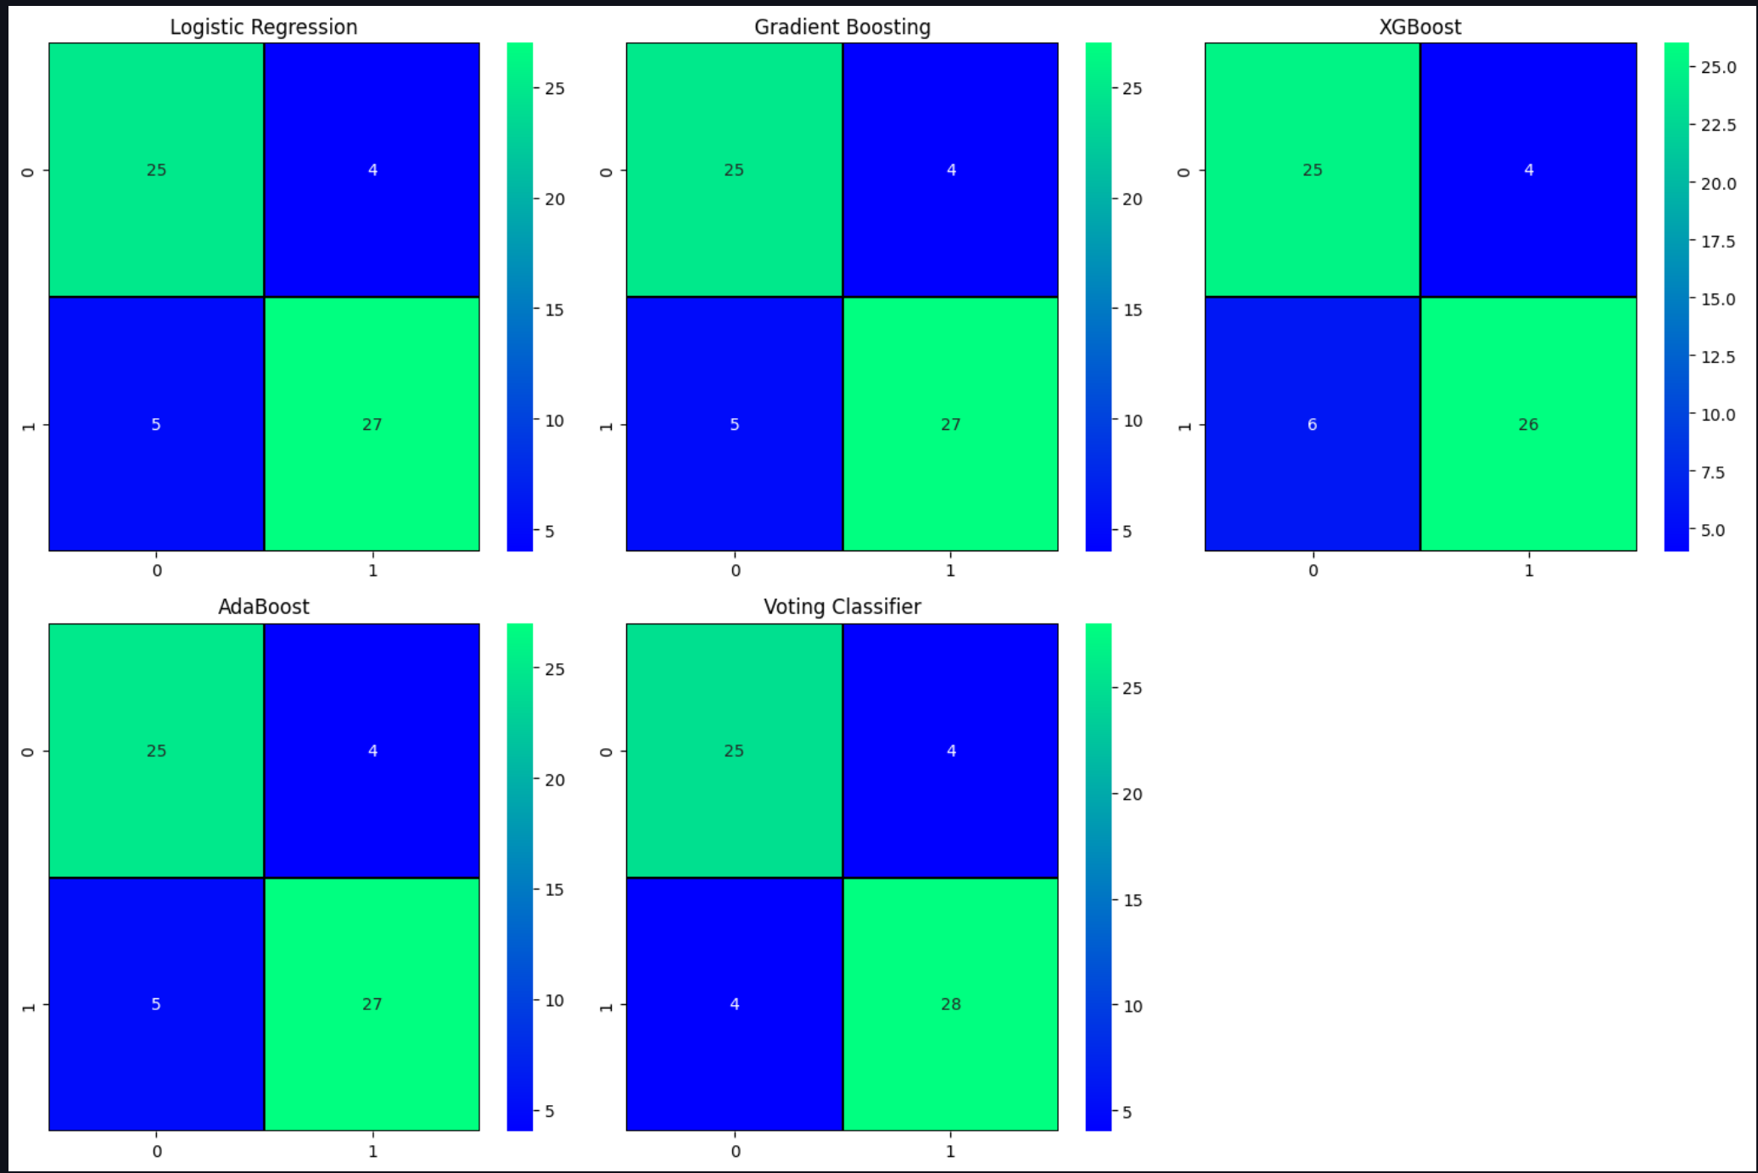
RESULTS
ENSEMBLE LOGISTIC ANALYSIS

Slide 38
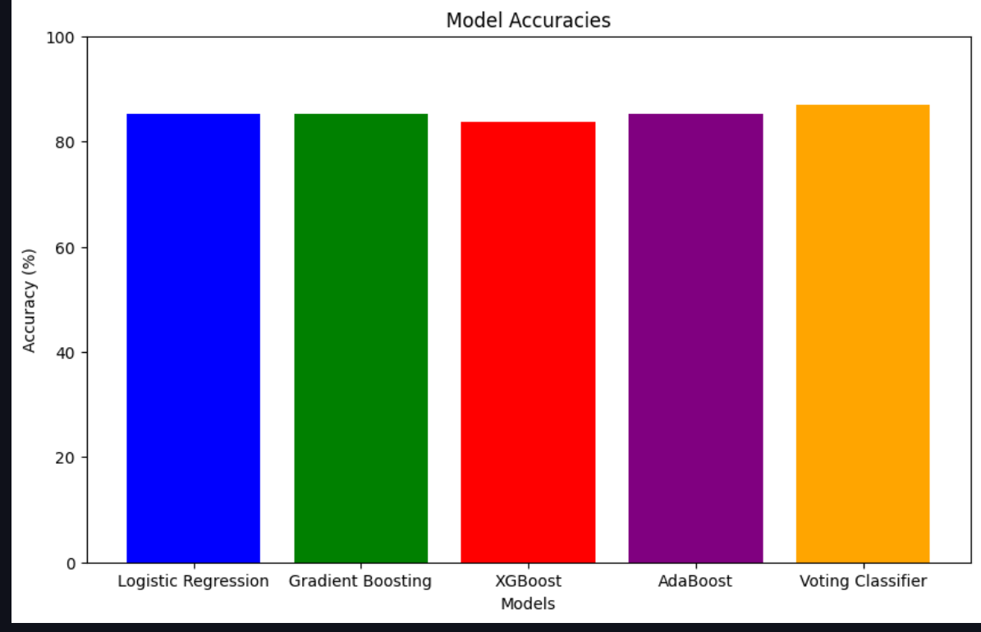
RESULTS
ENSEMBLE LOGISTIC ANALYSIS

Slide 39
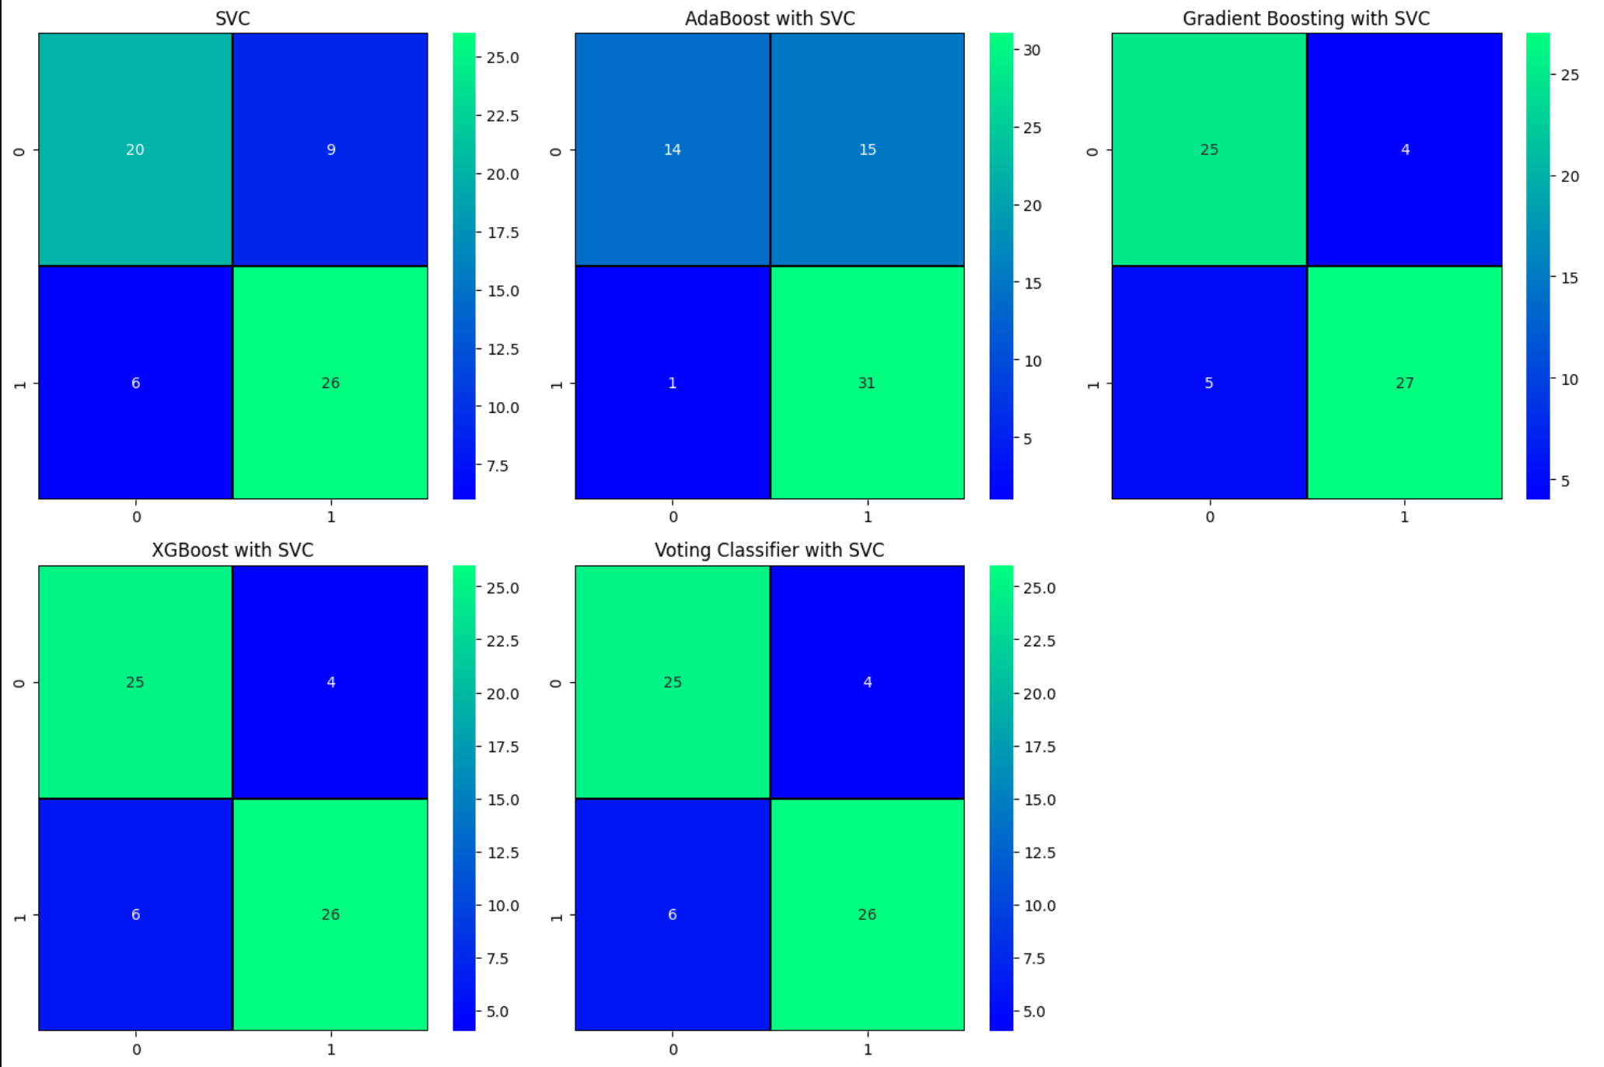
RESULTS
ENSEMBLE SVC ANALYSIS

Slide 40
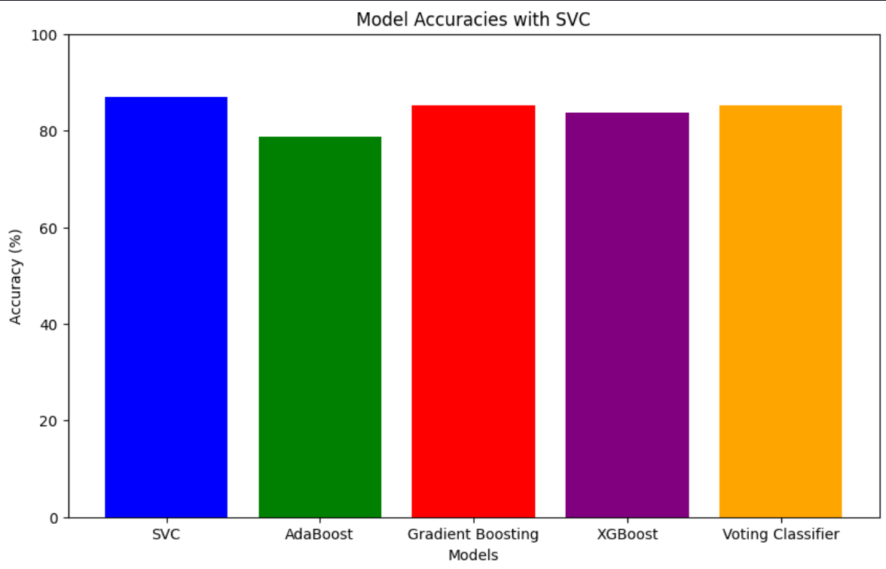
RESULTS
ENSEMBLE SVC ANALYSIS

Slide 41
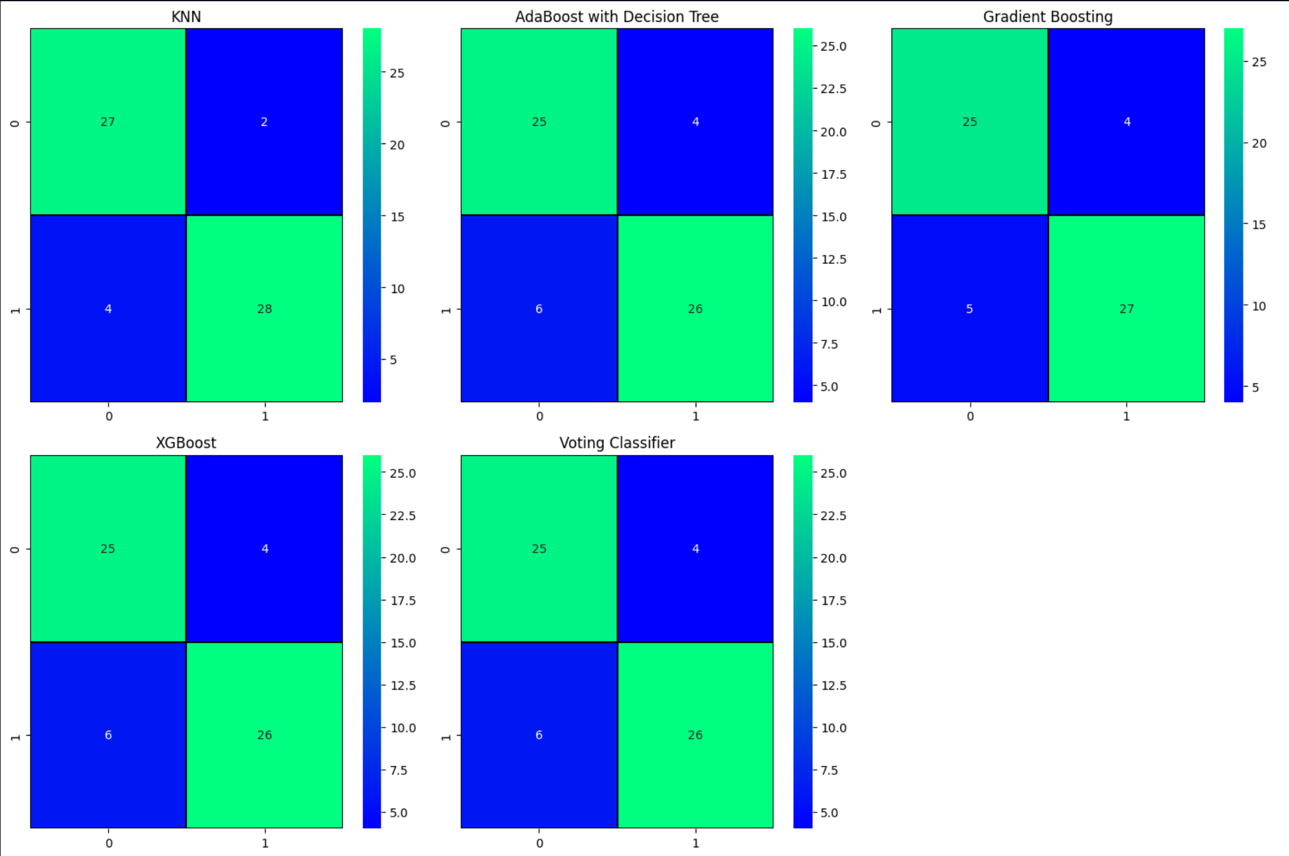
RESULTS
ENSEMBLE KNN ANALYSIS

Slide 42
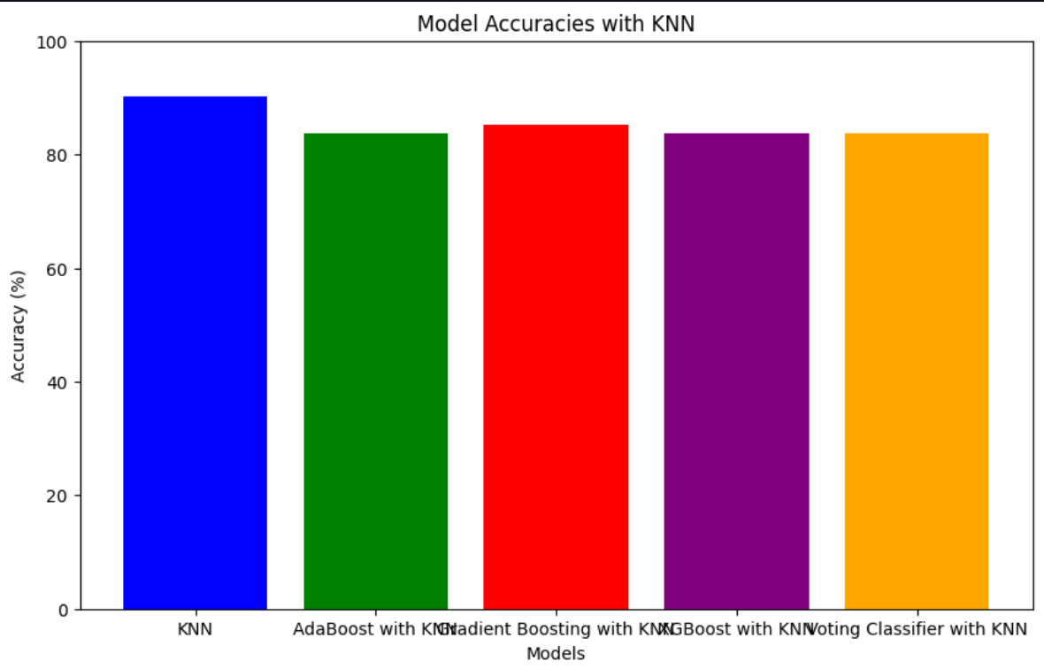
RESULTS
ENSEMBLE KNN ANALYSIS

Slide 43
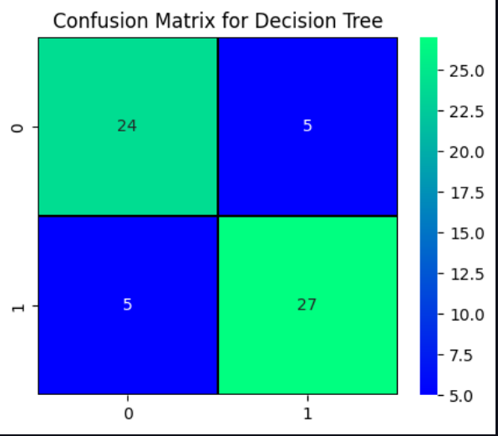
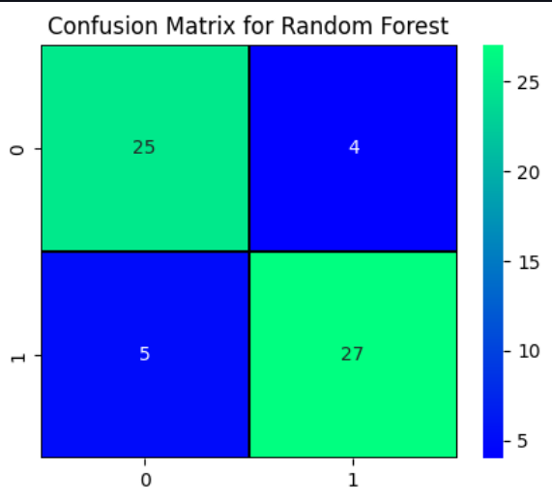
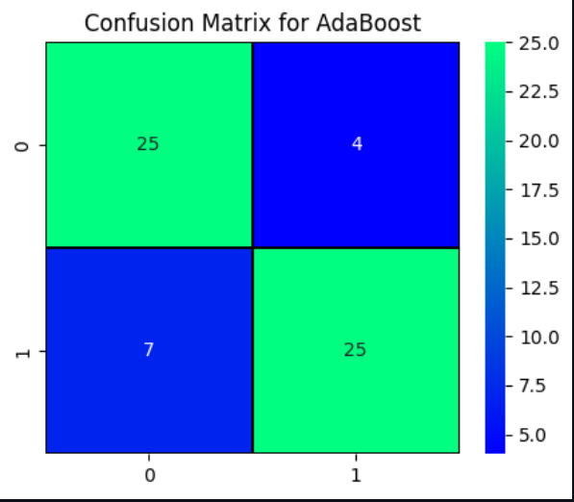
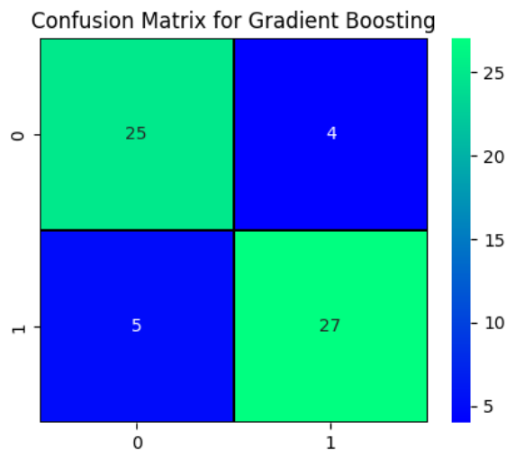
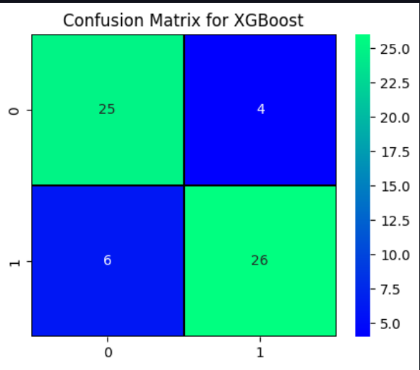
RESULTS
ENSEMBLE DECISION TREE ANALYSIS

Slide 44
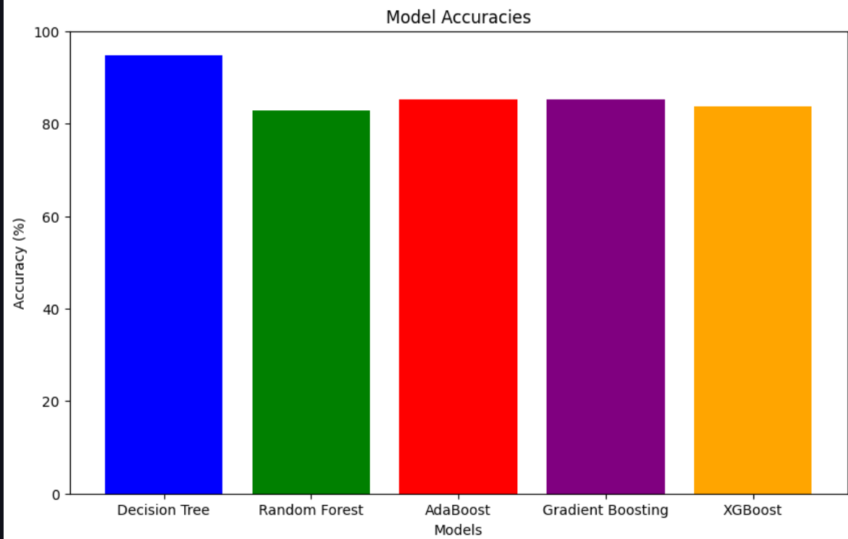
RESULTS
ENSEMBLE DECISION TREE ANALYSIS

Slide 45
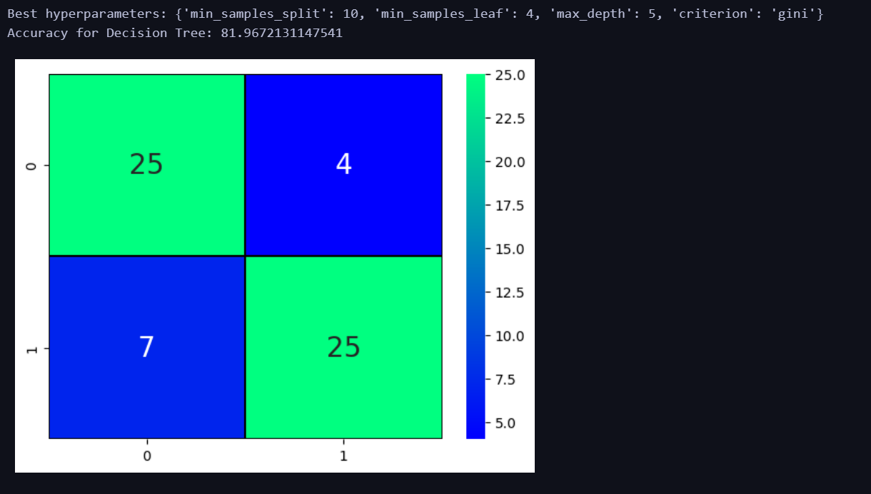
RESULTS
HYPERPARAMETER TUNING

Slide 46
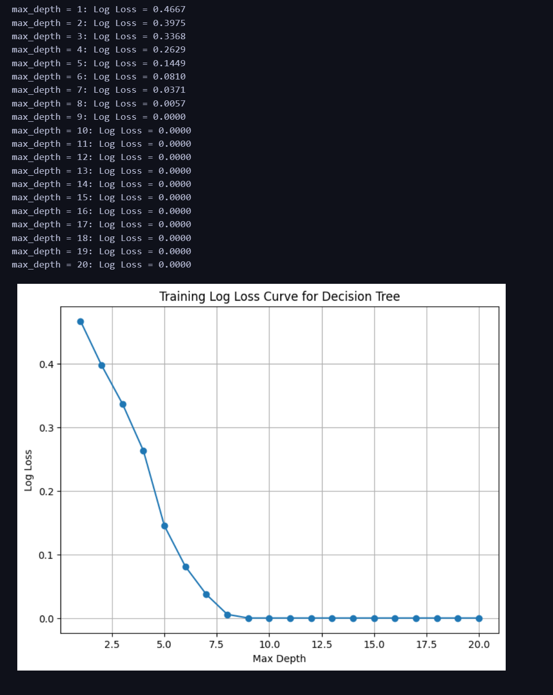
RESULTS
ERROR AND LOSS CURVES (DECISION TREE)

Slide 47
RESULTS
ERROR AND LOSS CURVES (DECISION TREE)

Slide 48
References
lnk for models:
https://towardsdatascience.com/building-a-logistic-regression-in-python-step-by-step-becd4d56c9c8
https://towardsdatascience.com/random-forest-in-python-24d0893d51c0
https://towardsdatascience.com/an-exhaustive-guide-to-classification-using-decision-trees-8d472e77223f
Papers:
https://ieeexplore.ieee.org/abstract/document/9362842/
https://ieeexplore.ieee.org/document/9848885
https://dl.acm.org/doi/abs/10.1145/3342999.3343015

